Slide 1
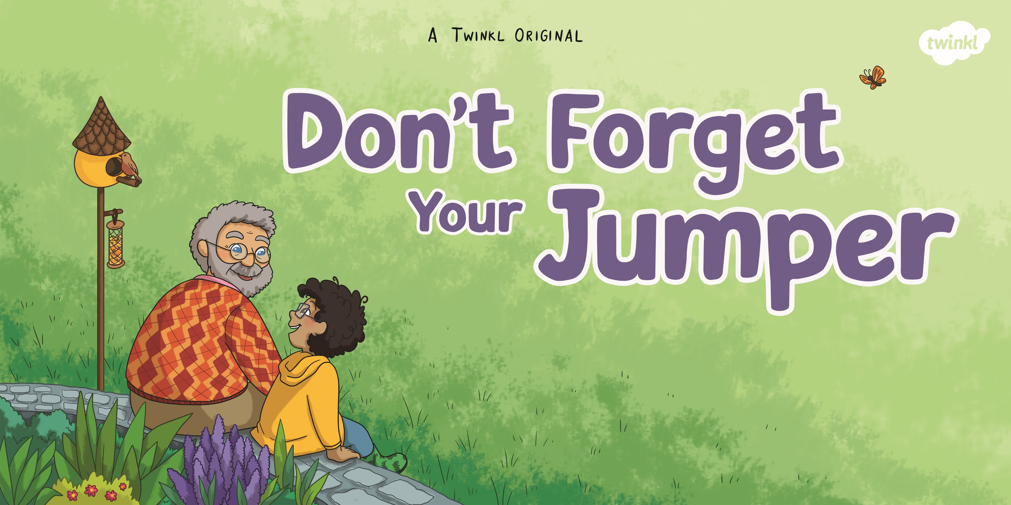

Slide 2
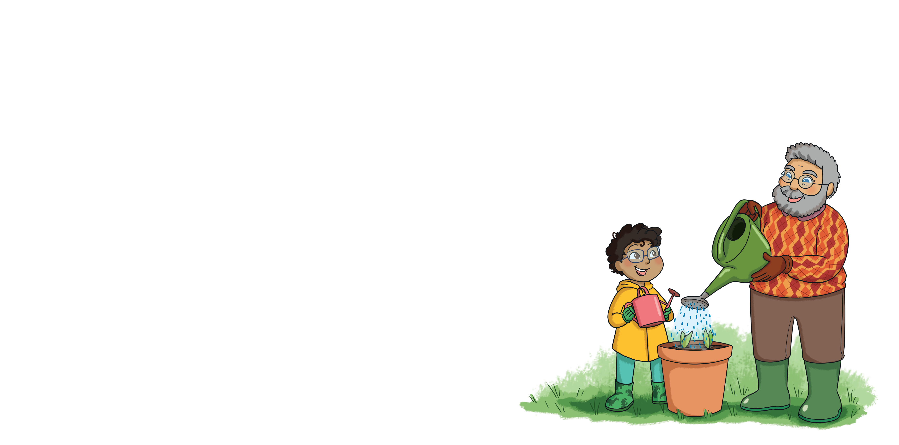

Slide 3
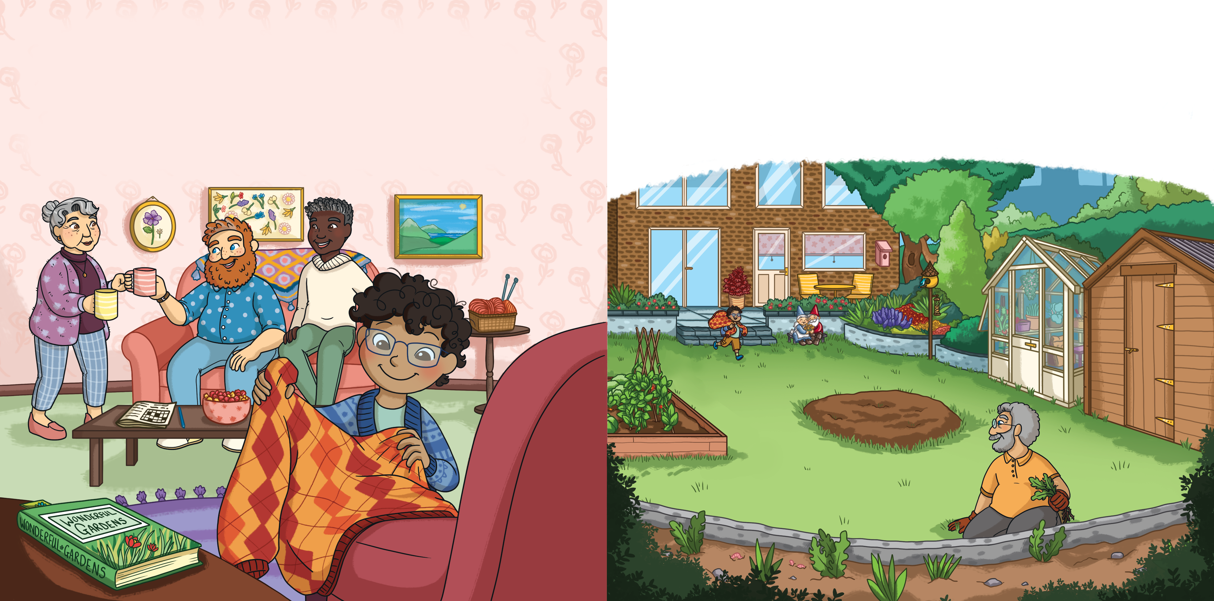
Monty arrived at his grandparents’ house with Dad and Daddy, like he did every Saturday. He gave Grandma a hug, then headed out to find Grandpa in the garden. On the way out, he passed Grandpa’s chair and picked up the soft knitted jumper resting on the arm.
“Don’t forget your jumper!” Monty called, running across the lawn.
“Thanks!” said Grandpa. “It’s chilly out today.”

Slide 4
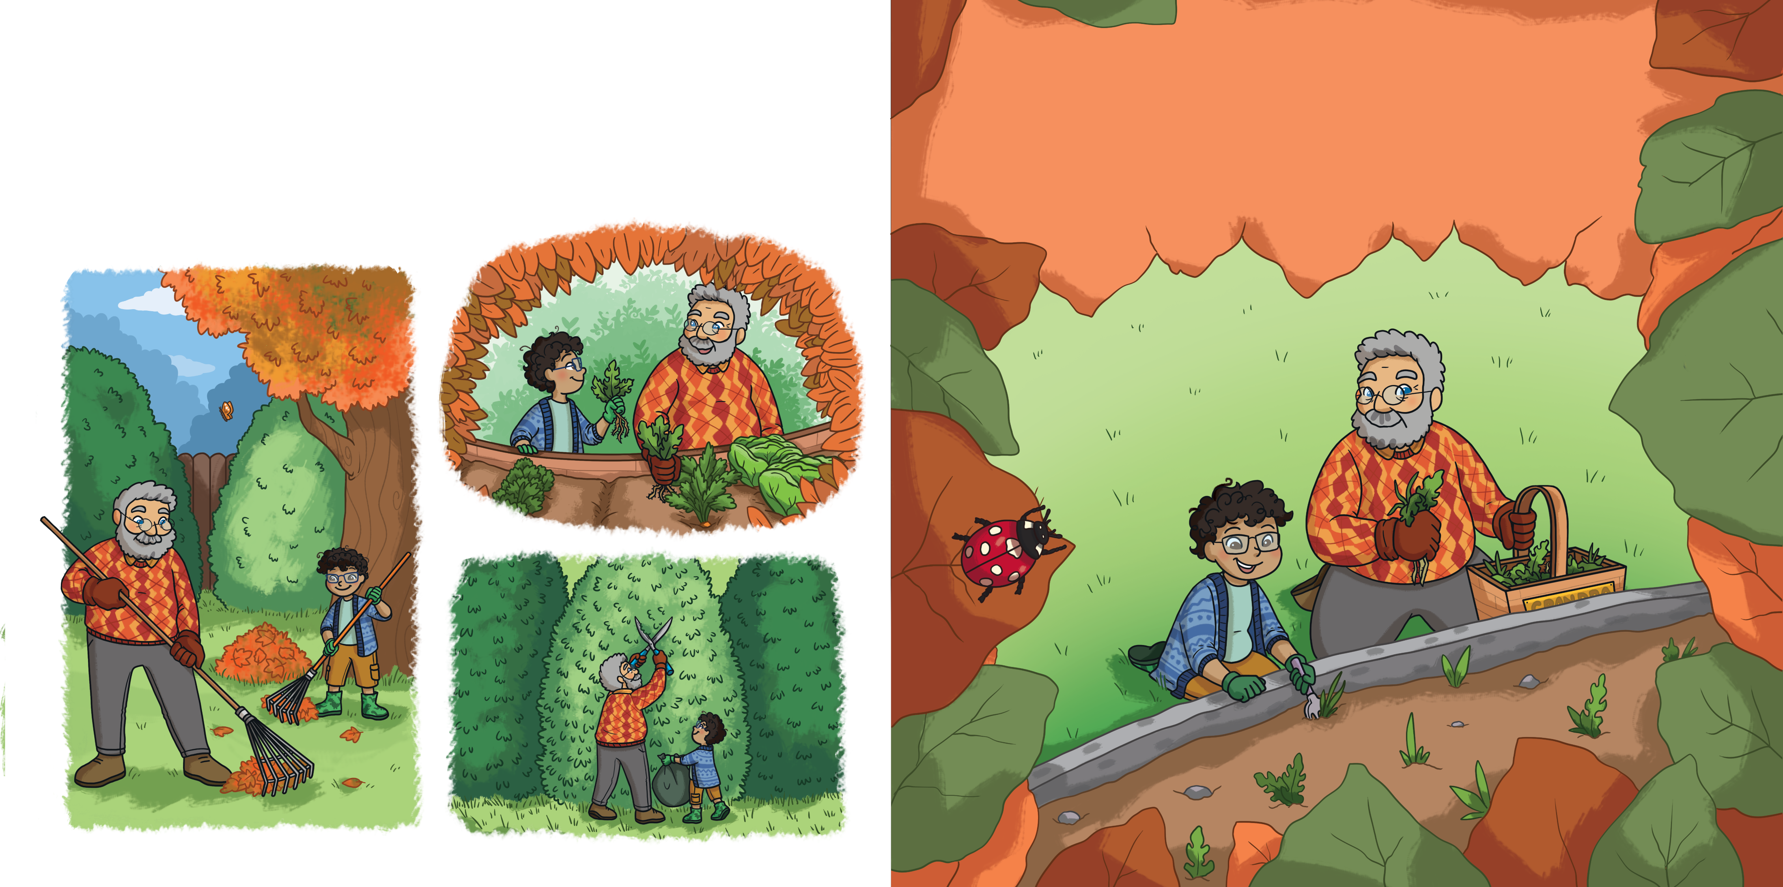
Grandpa knew everything about gardening. Monty loved learning the names of the plants and getting his hands dirty in the vegetable patch. Best of all, he loved seeing the daffodils come out in spring.
“Are we planting the daffodil bulbs soon?” Monty asked.
“Give it a few more weeks,” said Grandpa, handing him a gardening fork. “We need to get these weeds out first.”

Slide 5
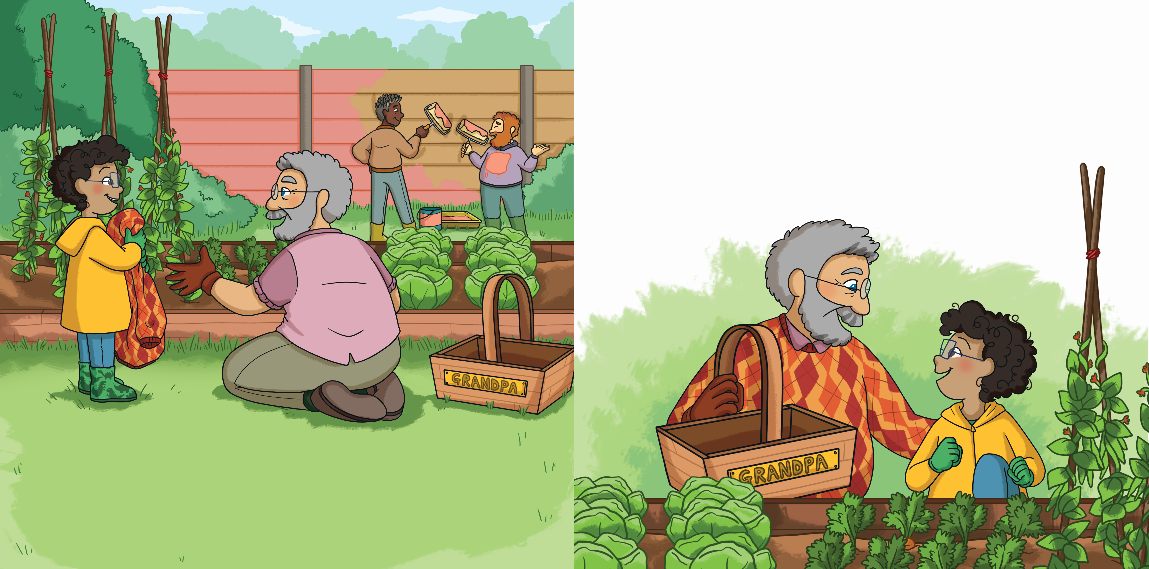
“Maybe we could plant the daffodil bulbs today,” suggested Monty.
“We’ll do it next week,” smiled Grandpa. “Today, it’s
carrot-picking.”
Monty grinned with excitement.
The next week, Monty arrived, ready for gardening. “Don’t forget your jumper!” he said.
“What would I do without you?” shivered Grandpa.

Slide 6
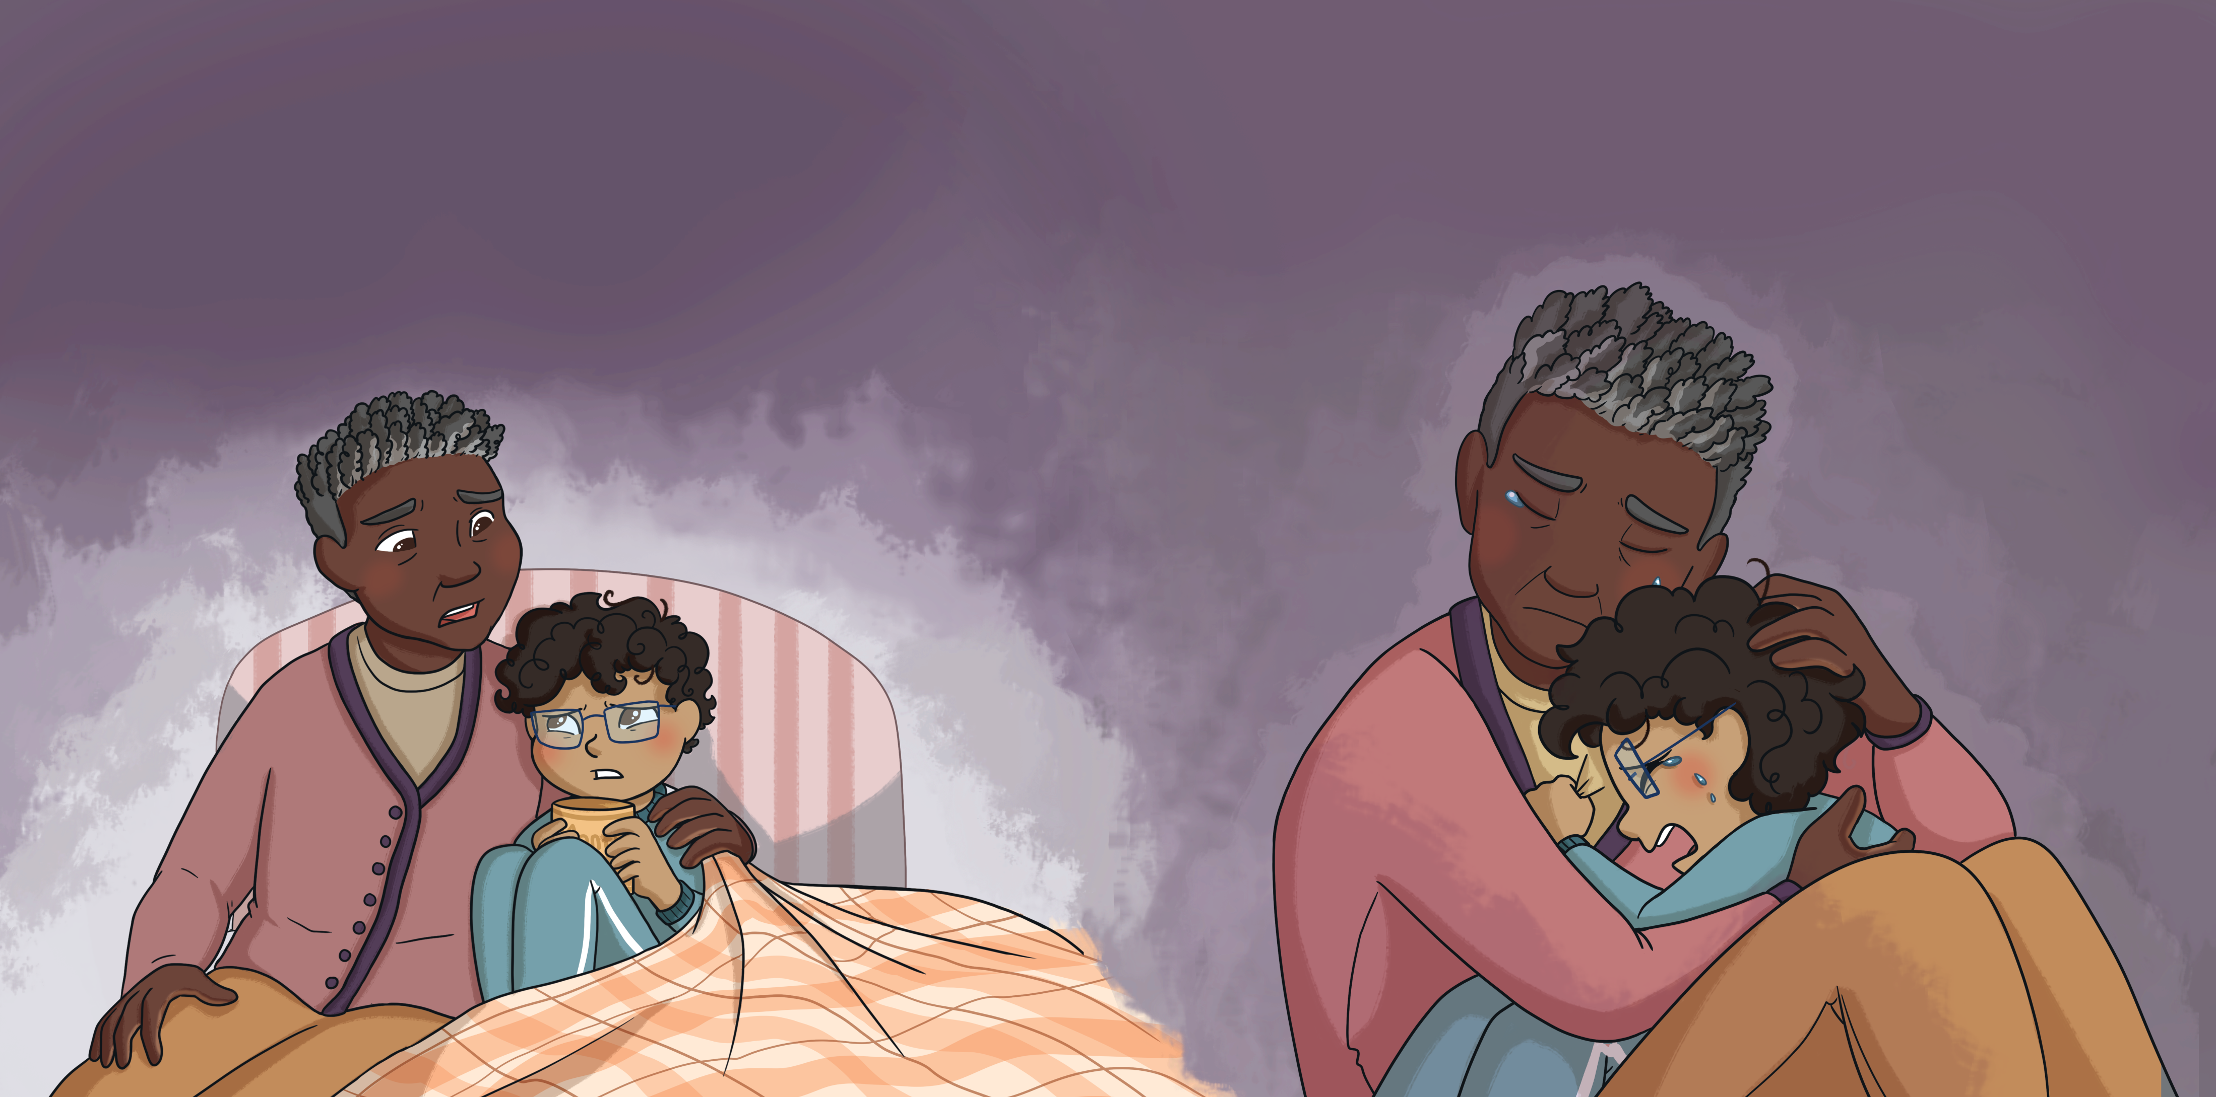
The following Saturday, Monty was woken by Dad, who had brought him a cup of warm milk. Dad snuggled up next to Monty and explained that Daddy was with Grandma. He had gone to see her on his own today.
Monty felt angry. He didn’t want Grandpa to be gone. Nothing felt the same any more and Monty’s tummy hurt. Dad wrapped him up in his arms and they both cried together.
There had been some very sad news. Grandpa had died.

Slide 7
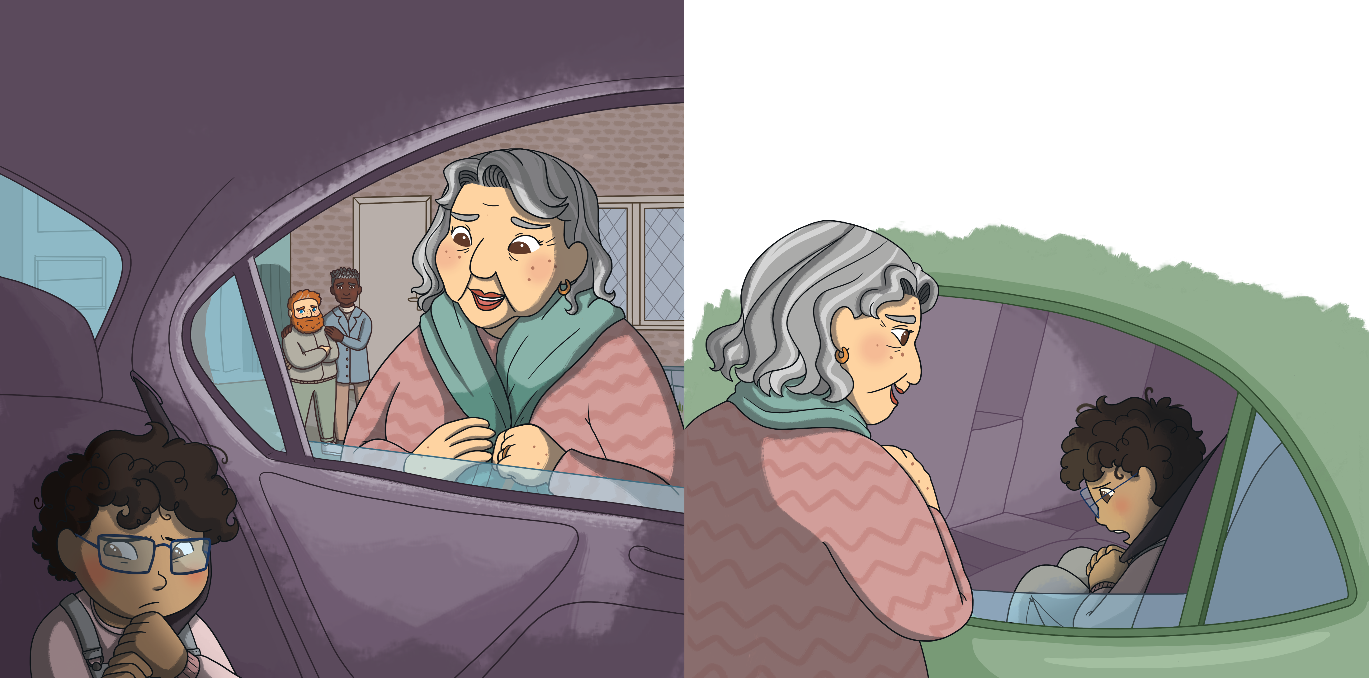
The next week, at Grandma’s house, Monty didn’t want to get out of the car. He felt worried.
“You can go and do some gardening if you like,” she said.
“I don’t know how without Grandpa,” said Monty.“Gardening was something I did with him but he isn’t here any more.”
Grandma came out to see him.

Slide 8
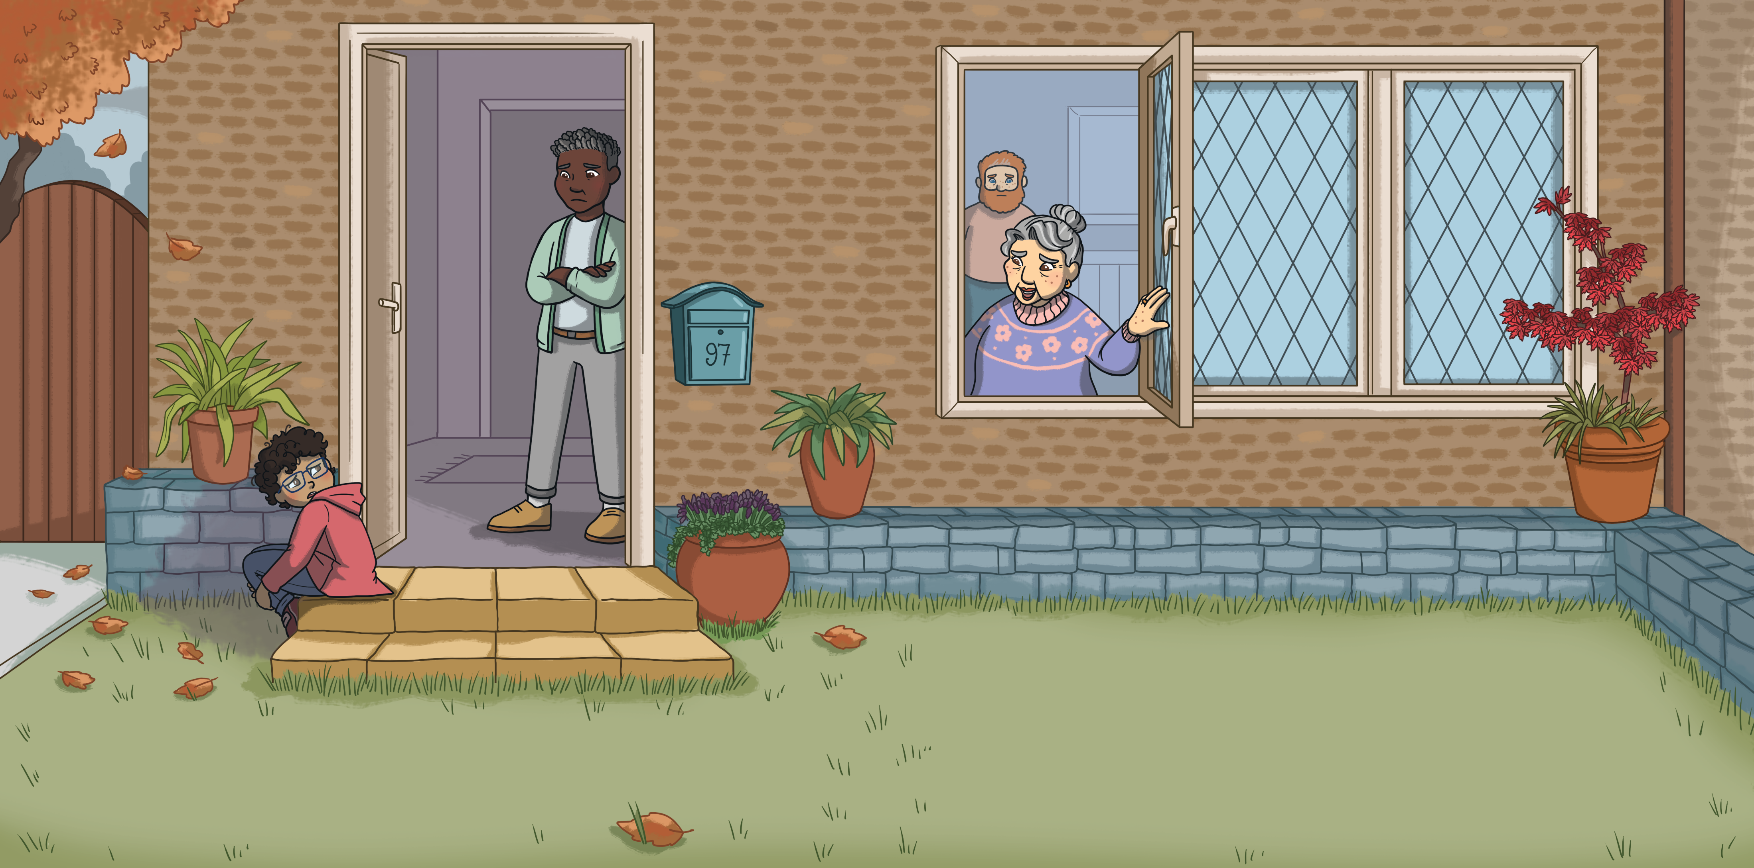
Grandma called out of the window, “Monty, why don’t you go and do some gardening?”
The next week, Monty sat by the front door while Dad and Daddy went inside. He felt lonely.
“I don’t know how without Grandpa,” said Monty. “Gardening was our special thing and I can’t do it on my own.”

Slide 9
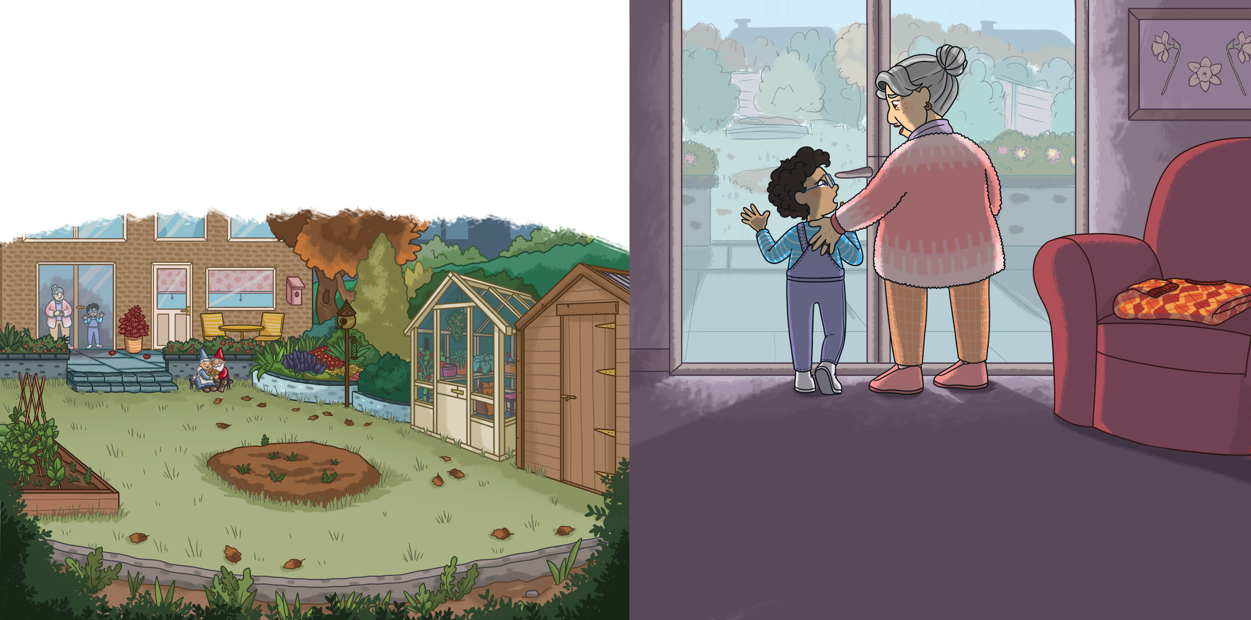
The next week, Monty stood at the living-room window.
Weeds were starting to grow in the vegetable patch and the plants needed tidying. He felt sad.
Grandma stood next to him.
“I wish Grandpa was still here,” said Monty.
“So do I,” said Grandma tearfully. “He may not be here but he left something behind for you.”
“What is it?” asked Monty.

Slide 10
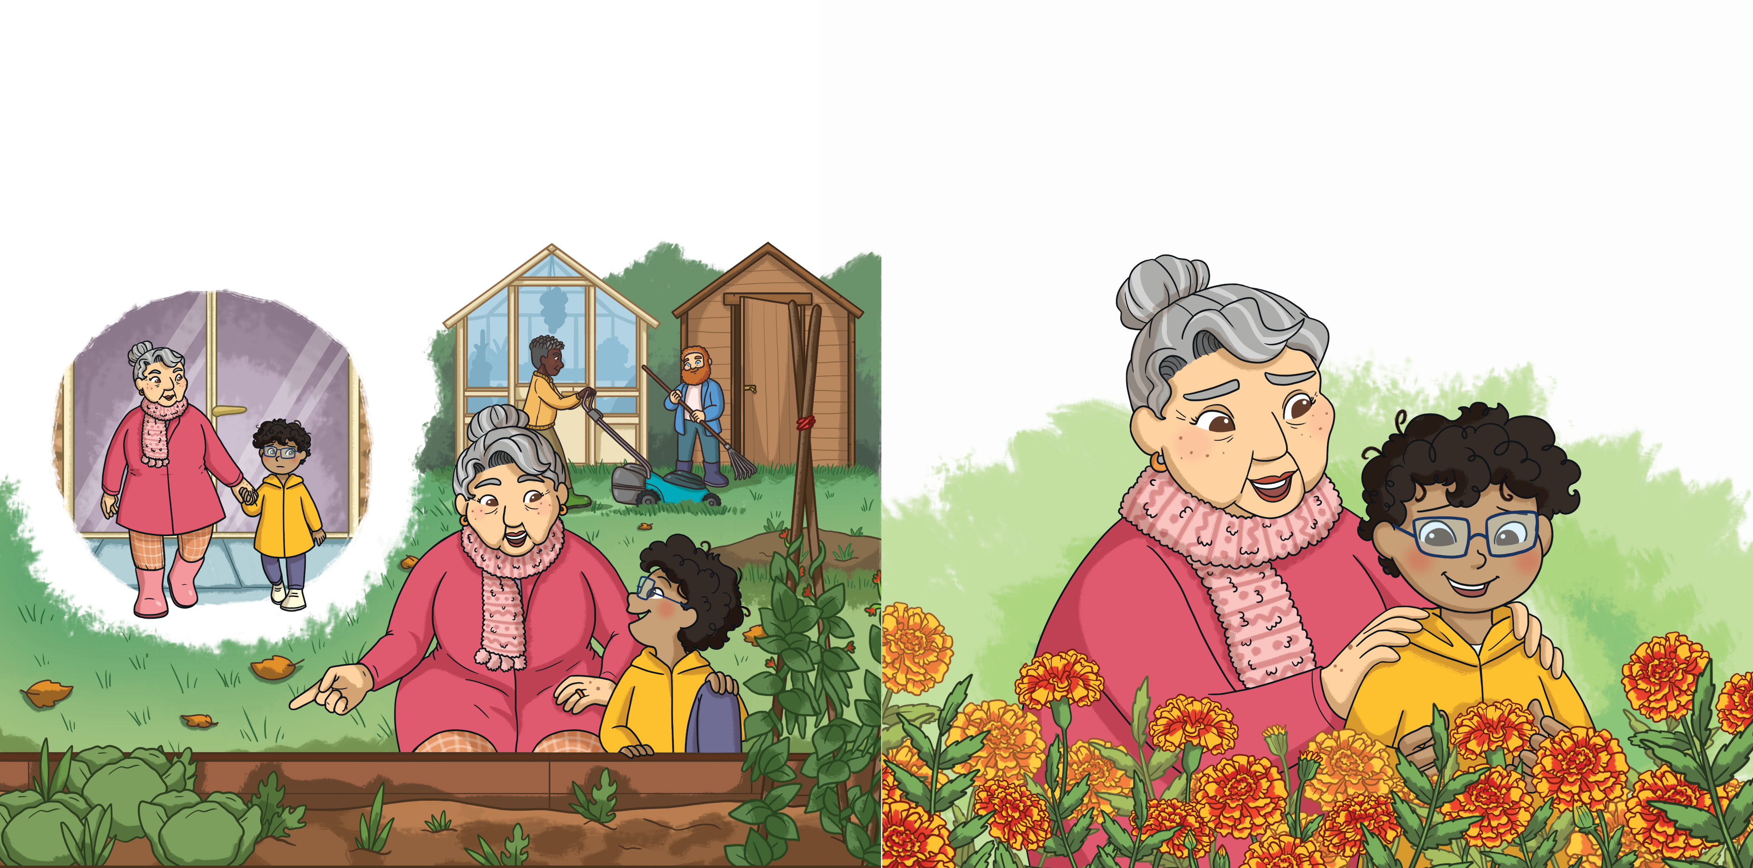
Grandma led Monty outside.
“That’s what Grandpa left you,” said Grandma. “Memories of all the time you spent together in this garden and everything he taught you along the way.”
She asked him questions about the plants and vegetables. She asked Monty to tell her everything he knew.
“I guess he did teach me a lot,” said Monty.
So he did.

Slide 11
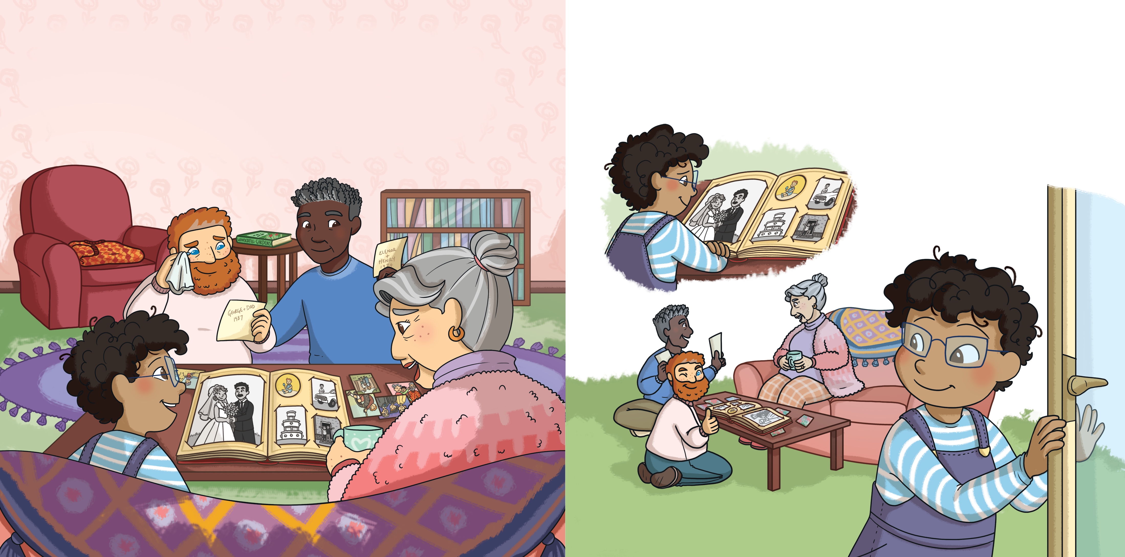
“What’s your favourite memory of Grandpa?” asked Monty.
Monty thought about how happy it would make Grandma to see the daffodils again next year. He knew how sad she was about losing Grandpa and wanted to make her smile.
“On the day we got married,” said Grandma, “he gave me a bunch of daffodils. Every year since then, he has planted them in our garden to make me smile.”
He sneaked outside...

Slide 12
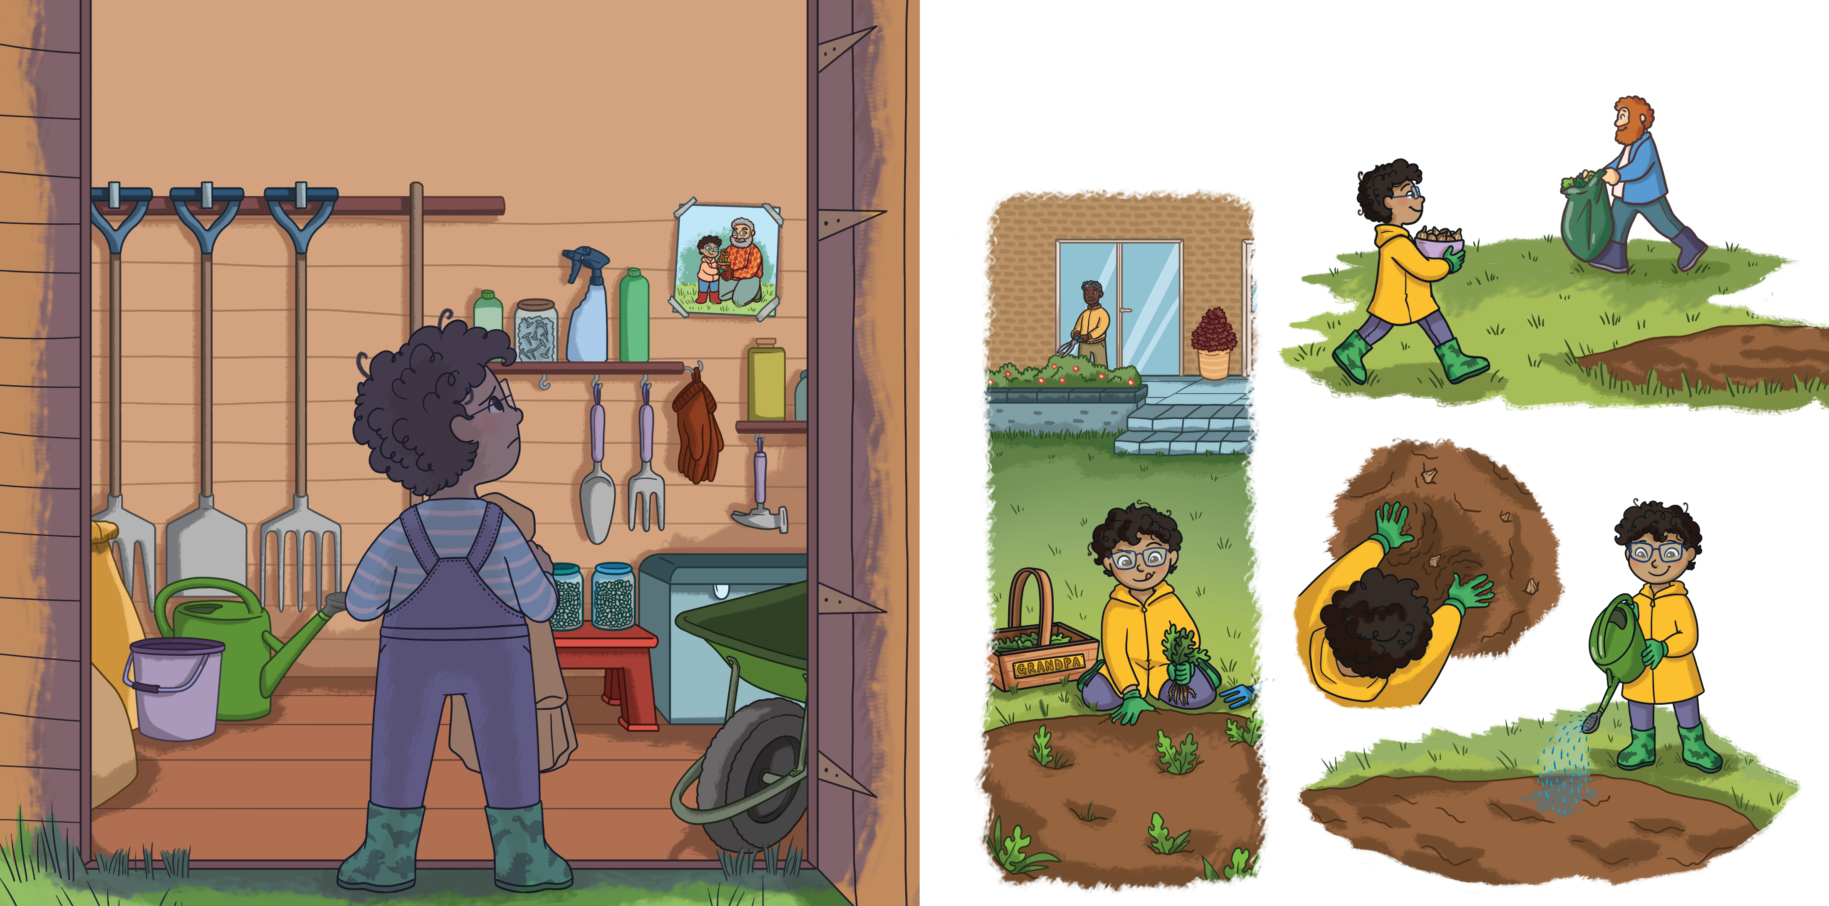
...and put on his wellies. He fetched the gardening tools from the shed. As he opened the door, he felt a rush of sadness. Everything made him think of Grandpa.
Monty spent the rest of the day digging, planting and watering.

Slide 13
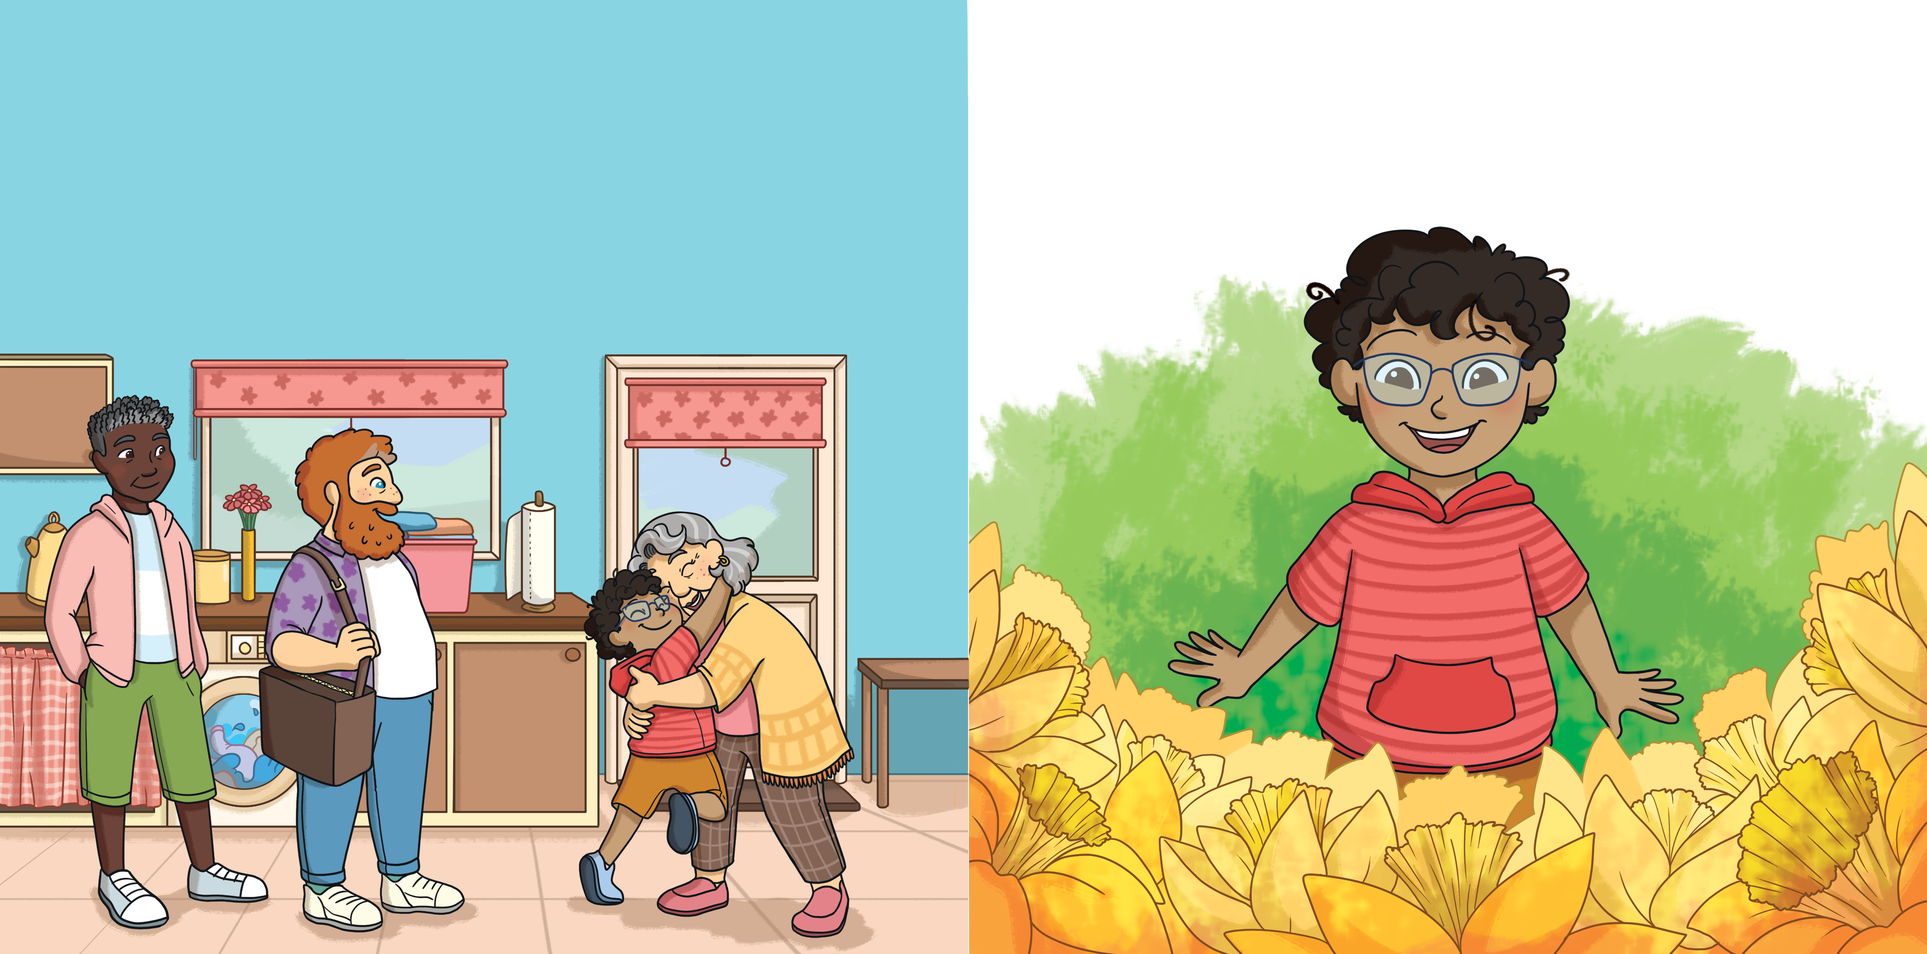
When spring came, Monty arrived at Grandma’s house with Dad and Daddy, as usual.
Monty ran out to the garden as quickly as he could. There, in the middle of the lawn, was the most beautiful flowerbed full of bright yellow daffodils, swaying in the cool breeze.
Grandma was grinning and gave Monty the biggest hug ever.
“You wonderful boy,” she said. “Your Grandpa would have been so proud of you.”

Slide 14
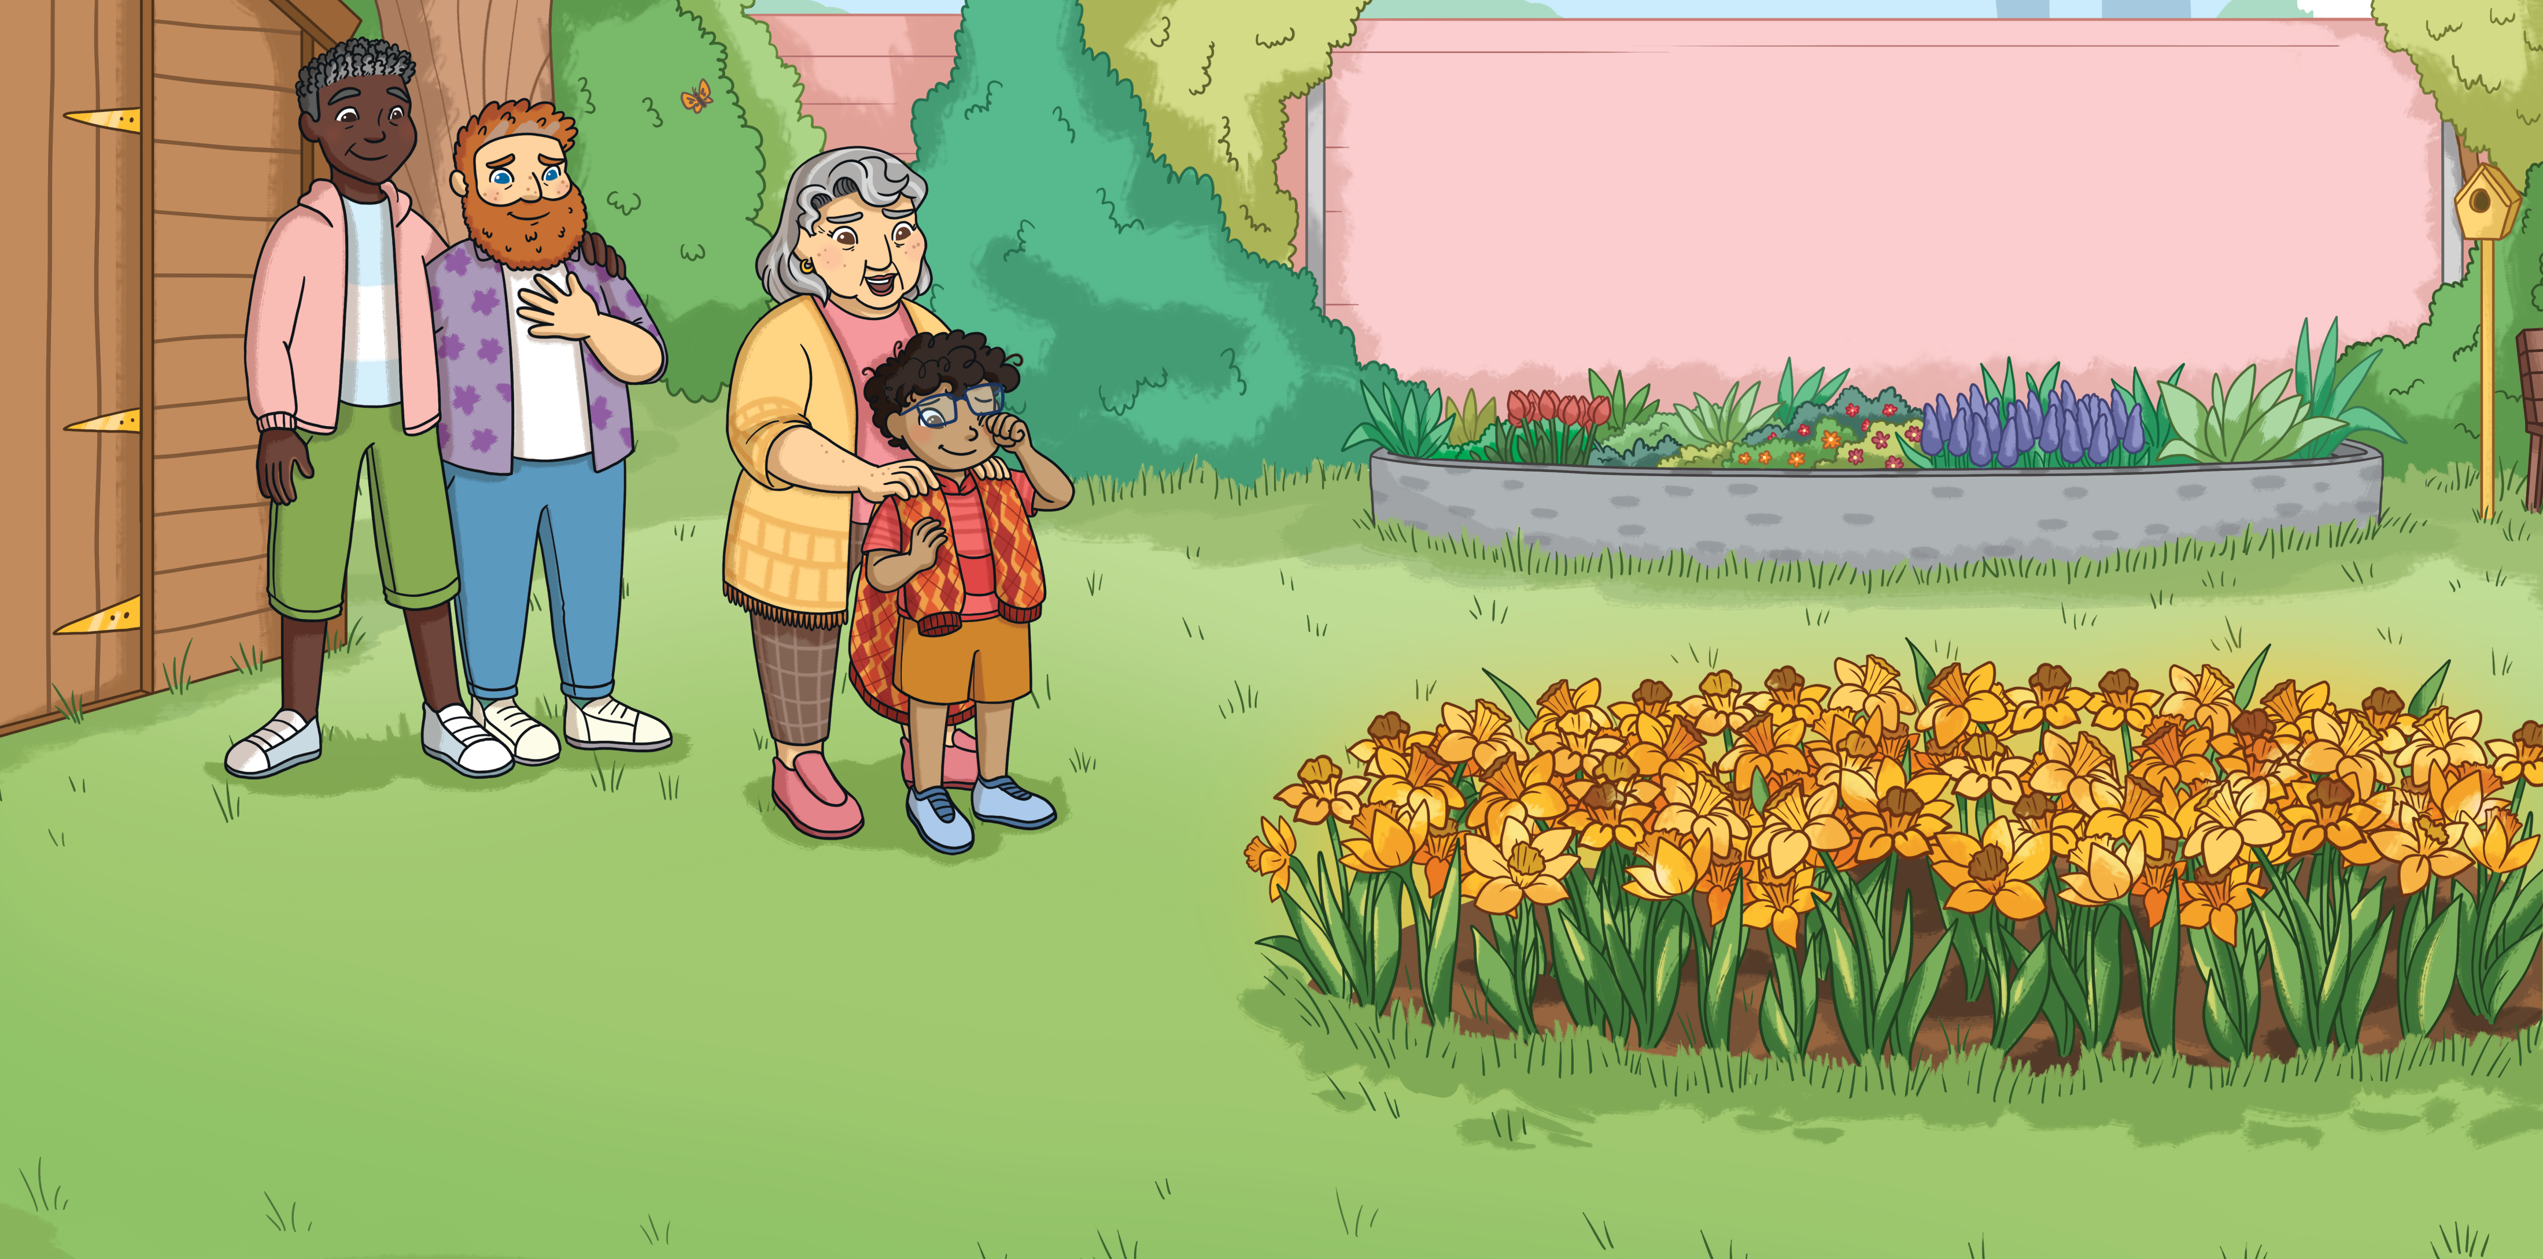
“I remembered everything he taught me,” said Monty. “He was a good teacher.”
“The memories we made together will always be with us,” said Grandma. “And that’s why Grandpa will be too.”
“Don’t forget your jumper,” Grandma smiled. She handed him Grandpa’s jumper and Monty wiped a tear from his face.
“They bloomed a few days ago and made me think of Grandpa,” said Grandma. “Thank you, Monty.”

Slide 15


Slide 16
