Slide 1



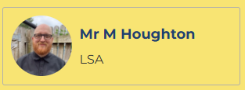
Welcome to Class 6
Mr. Hunt, Mrs Bye and Mr Houghton
Notes:
Roles within the class

Slide 2
Expectations
Correct school uniform (named)
Correct PE kit ( named)
Water bottle (water and not juice, named)
Coat
Hat/Suncream in warm weather
Attendance
Children need to be in school by 8:40am each day.
It is paramount that children are in school as much as possible. As a school our attendance target is 97%.
Notes:
Aim for all to achieve to the best of their ability

Slide 3
Expectations
Learning Behaviours- last year of Primary School so will be preparing for transition to Secondary School:
Independence: - being prepared for lessons
( resources / PE kit, correct school uniform /attendance etc)
using resources/displays to support independent learning.
Responsibility – for learning and behaviour.
Notes:
Aim for all to achieve to the best of their ability

Slide 4
Year 6 – Expectations :
Reading, ( Accelerated Reader)
Spelling,:
Grammar,
Writing, ( including cross –curricular)
Maths. –include recall of multiplication and related division facts- please encourage regular practice over the holidays
Notes:
Expectations of presentation- completion of tasks

Slide 5
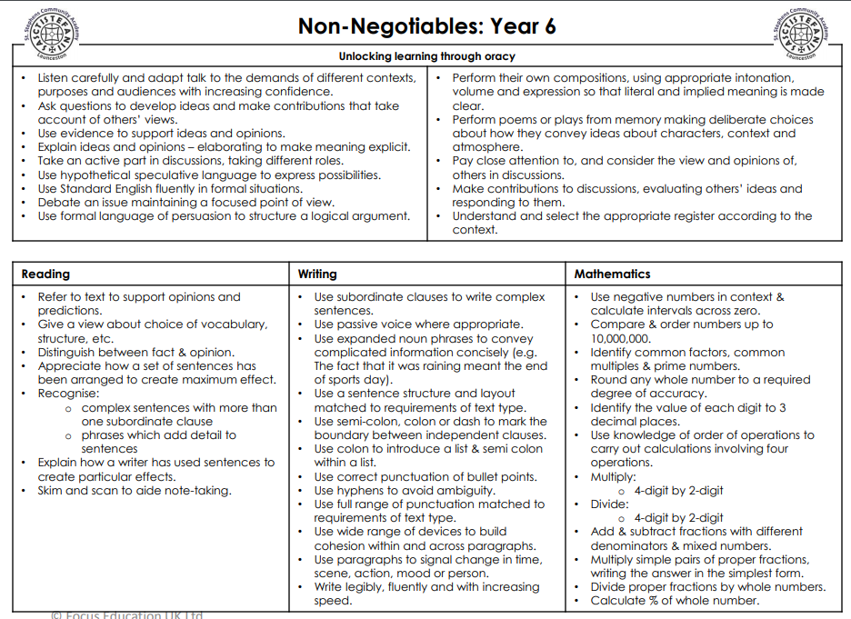

Slide 6

Bikeability
Learn 2Ride and Bikeability Level 2 will commence on w/c 29th September:
A link will be sent out to be completed.
Prior to sessions beginning you will be informed on which day your child’s sessions are.

Slide 7
End of KS2 SATs 2025/2026
Monday 11th May- Thursday 14th May 2026
Grammar and Speliing
Reading
Maths: Arithmetic Paper 1 and Reasoning Paper 2
Maths: Reasoning Paper 3
Writing and Science Levels are Teacher Assessed.

Slide 8
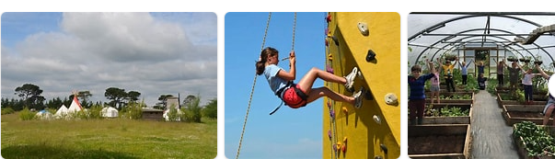
Year 6 Residential
27-29th June 2022
Camp Kernow has provisionally been booked for 22nd-24th June 2026 further details to follow.
https://campkernow.org.uk/

Slide 9
Homework
Maths and English Homework Books ( at times My Maths and SPAG.com will be set )
Reading ( Accelerated Reader books- see following slides)
Any work which is not completed in class/school.
( children will be provided with their logins in September for My Maths and SPAG.com)

Slide 10
Home Reading
Accelerated Reader: A Guide for Parents
From Year 2 -6, all children take part in the Accelerated Reader programme, which is designed to do the following things:
Find books that are the right level for your child
Encourage your child to read more
Improve your child’s reading ability.
https://educationendowmentfoundation.org.uk/projects-and-evaluation/projects/accelerated-reader/#closeSignup

Slide 11
Home Reading
“How much should my child read each day?”
According to Renaissance Learning’s research, children who read at least 20 minutes a day with a 90% comprehension rate on AR quizzes see the greatest gains.
Therefore, your child should have at least 20 minutes set aside for reading during day.

Slide 12

Communication
Letters home via email- spares can be collected from
the office.
Texts
Website: check for key dates and upcoming events
St Stephens Facebook page
Newsletter emailed out- this also contains key information.
Termly overviews.
Please make appointments at reception if you would like to see your child’s teacher.
Please ensure that contact details and medical details are up to date.

