Slide 1
















St Stephens Community Academy
PARENTS’
Engagement Policy

Slide 2



This Policy provides a clear framework for:
STATEMENT OF INTENT
1.
How our school communicates with families.
2.
The ways in which families can ensure they are fully involved in every aspect of the school community.
3.
Support their children’s learning.

Slide 3

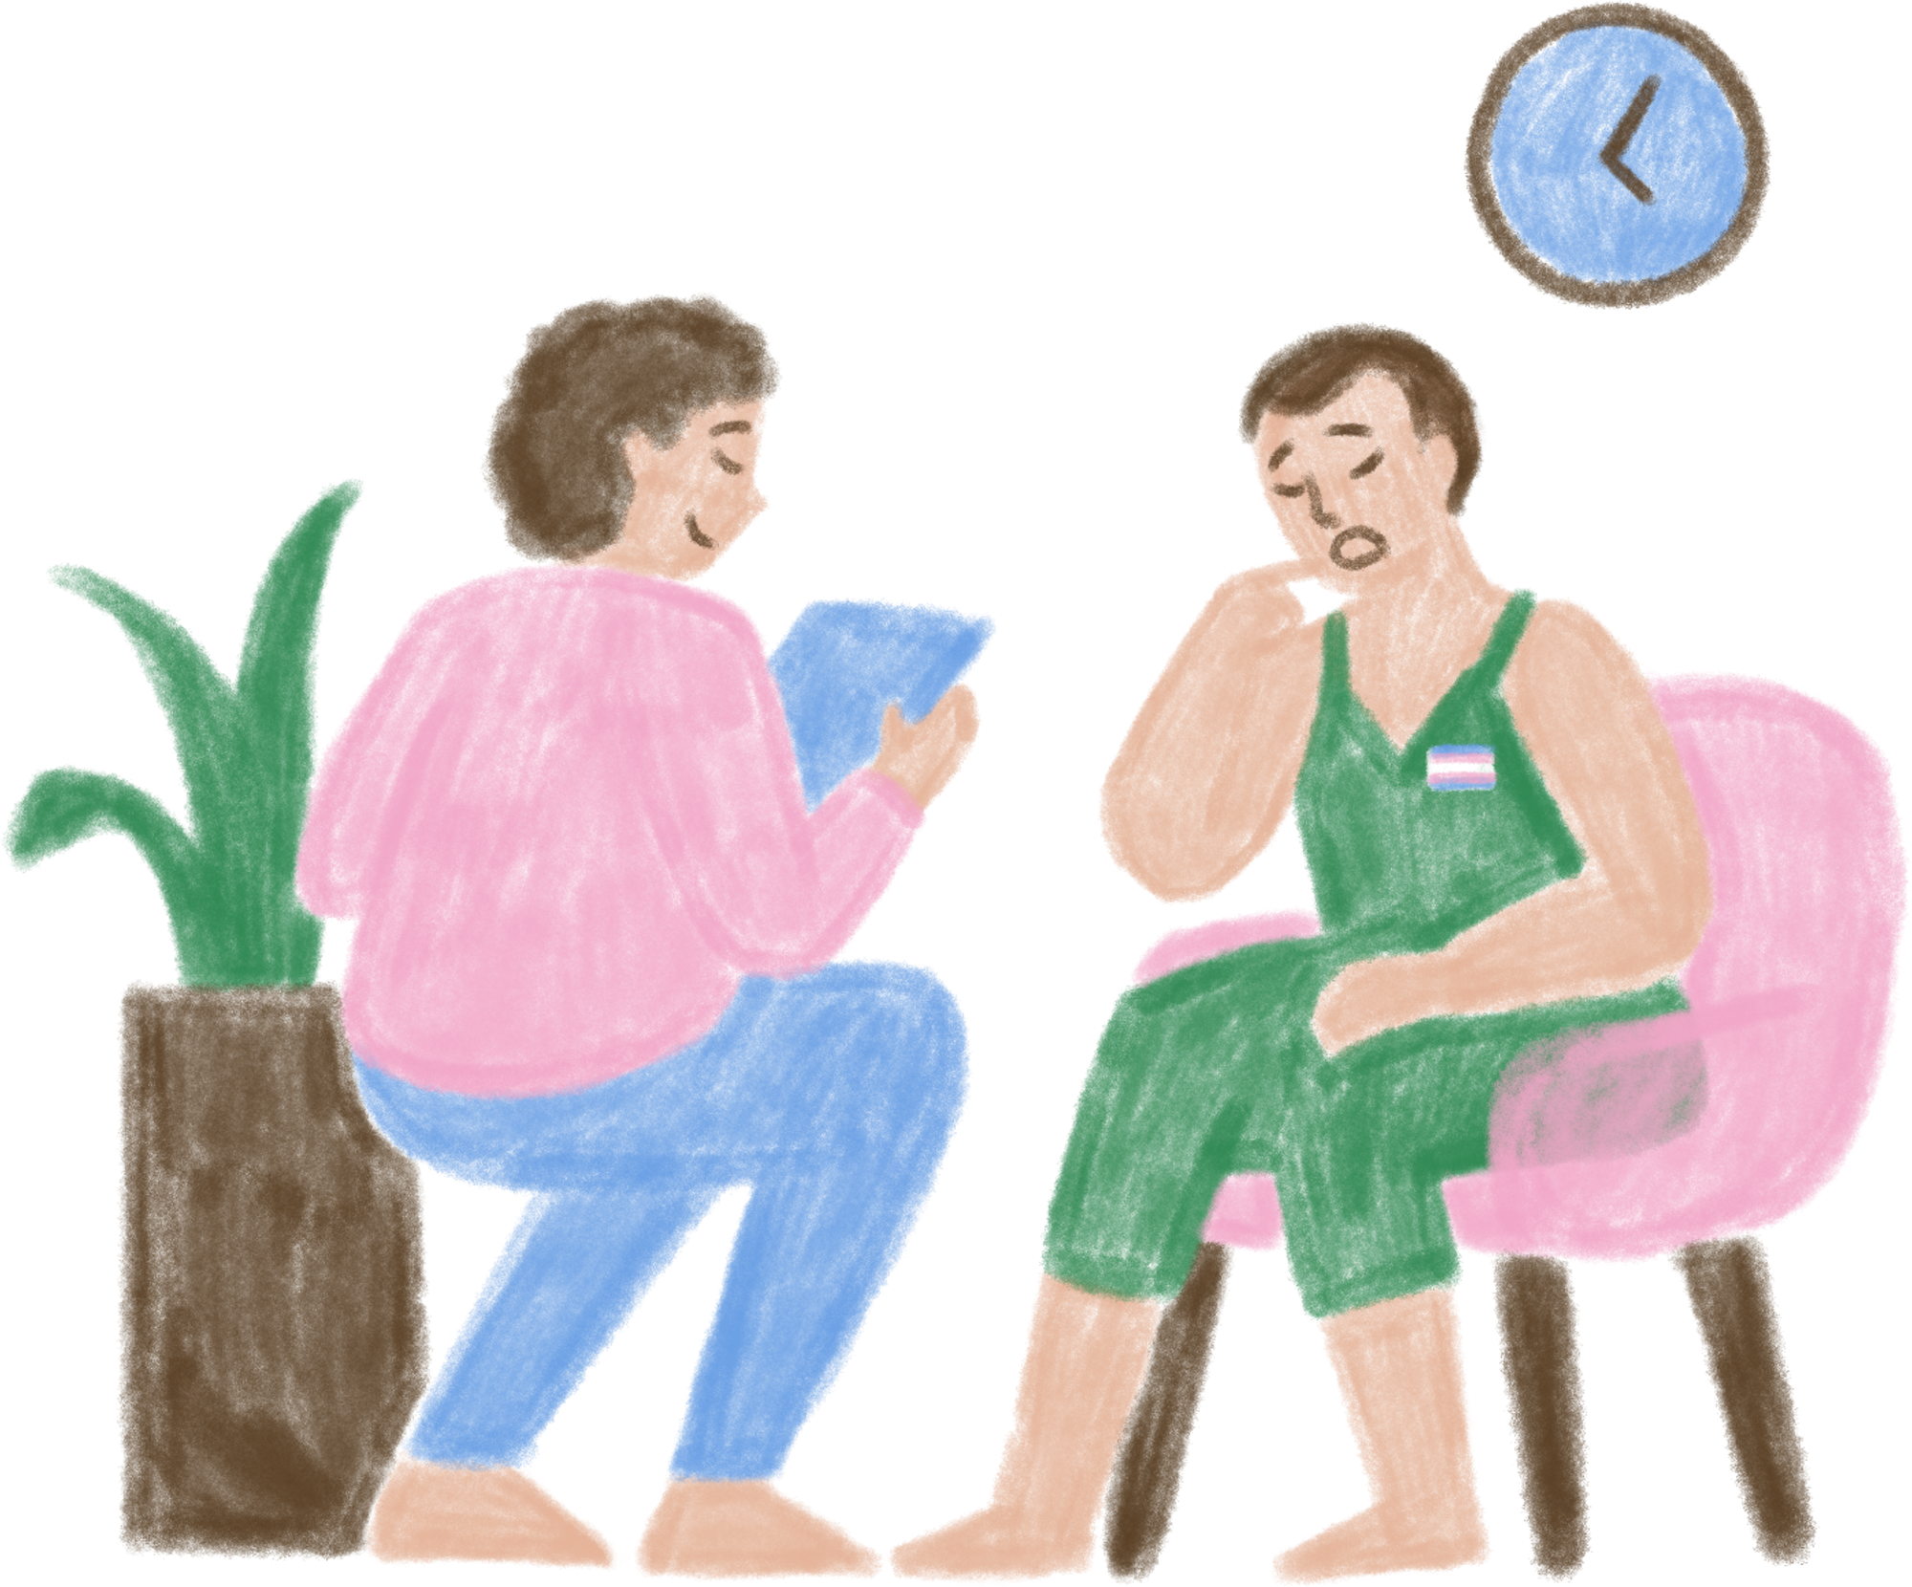


OUR AIMS
To be helpful, communicative and supportive of parents.
To be welcoming to and inclusive of all parents.
To involve all parents in all apects of their child’s progress and wellbeing.
To establish the views and opinions of parents and act on them.
To encourage and empower parents.

Slide 4

ROLES AND RESPONSIBILITIES
The School
Communicating the curriculum clearly to all parents.
Listening to the views and concerns of parents.
Informing parents of all school events withing appropriate timelines.
Providing opportunities for parents to communicate with the school regularly to provide their feedback.
Regularly keeping parents informed of their child’s progress and helping parents support their child’s learning.

Slide 5


ROLES AND RESPONSIBILITIES
For Parents
Use the school website ‘Parent Hub’ for key information
Share important information about your child - eg medical/ safeguarding
Read key communications
Respond and act on these
Attend meetings
Return forms
Communicate absences
Raise concerns you have directly with the class teacher in the first instance
Engage in opportunities to provide feedback

Slide 6




Teachers2 Parents App
FOR DAY-TO-DAY INFORMATION, REMINDERS, MESSAGES BETWEEN TEACHERS AND PARENTS AND SHARING LEARNING.
10. END OF YEAR REPORT
STATUTORY REPORTING FOR PARENTS ON THEIR CHILD’S PROGRESS AND ATTAINMENT ONVER THE ACADEMIC YEAR/OUTCOMES OF ANY STATUTORY TESTS AND ATTENDANCE
SYSTEMS OF COMMUNICATION
2. SCHOOL WEBSITE
FOR USEFUL INFORMATION - TERM DATES, SCHOOL UNIFORM ORDERING, SCHOOL LUNHC MENU AND PARENT SIGNPOSTING.
9. PARENTS CONSULTATIONS/EVENINGS
FOR DISCUSSING PROGRESS/ATTAINMENTS/ ATTENDANCE/CONCERNS/ TARGETS
8. ASSEMBLIES AND PERFORMANCES
FOR SHARING AND CELEBRATING YOUR CHILD/REN’S ACHIEVEMENTS
4. TEXT SYSTEM
FROM SCHOOL FOR URGENT CONTACTS - EG SNOW DAY/CANCELLED CLUB.
3. SCHOOL FACEBOOK AND INSTAGRAM
FOR SHARING AND CELEBRATING LEARNING AND EVENTS.
6. LETTERS HOME
FOR SIGNED PERMISSION FOR EVENTS/TRIPS
5. NEWSLETTER
CELEBRATING OUR SCHOOL, SIGNPOSTING, DATES FOR THE DIARY
7. FEEDBACK AND SURVEYS FOR GAINING AN INSIGHT INTO WHAT WORKS WELL/WHAT CAN BE IMPROVED

Slide 7
COMMUNICATING PUPIL PROGRESS AND INFORMATION
Parents are:
-invited to attend a meet the teacher meeting in the summer term;
-invited to attend 2 parents’ evenings per year;
-invited to meetings to discuss their child where the teacher deems it necessary;
-invited to one-to-one meetings, as appropriate, for parents to discuss and review any individual educational plans;
-invited to schedule one-to-one meetings with the class teacher in the first instance and as necessary with the mental health lead, SENDCo, Headteacher or other relevant staff member to discuss areas of concern;
-able to address class teachers at the start and end of the school day at the classroom door for urgent matters;
-able to view celebration of pupil progress and learning on the school’s social channels;
-able to view celebration of educational achievements in letters home, assemblies, events and presentations;
-able to view curriculum information on the school Face Book page and on class pages on the school website;

Slide 8




PROVIDING SUPPORT
The school aims to:
Run various assemblies, training sessions, coffee mornings or workshops to help parents with issues they and their child may face.
Support parents in every way possible with the educational development and wellbeing of their child.
provide details of both internal and external support organisations they can access for their child’s or family’s needs.

Slide 9
PARENTAL FEEDBACK
The school will consult with parents on various aspects of school life throughout the year:
Questionnaires will be available online.
The school will arrange regular consultations, such as school forums, questionnaires, feedback forms, to seek parent feedback.
All parental feedback is valued, and all responses are considered.
Parents are encouraged to provide feedback through online consultations and when they need to additionally via the school email: ststephens@andaras.org

Slide 10




KEY DOCUMENTS
The school publishes key documents and policies on the school website.
Parents can download these documents.
The school aims to create documents that are accessible to parents and easy to understand.

Slide 11




THANK YOU

