Slide 1
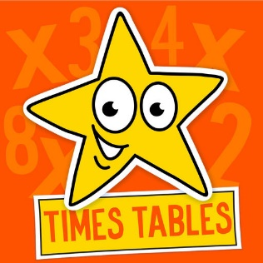
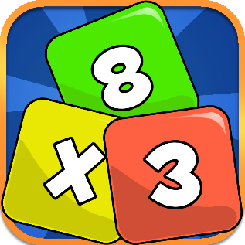
Multiplication Tables Check
Parent/Carer Information

Slide 2

Content
• Curriculum expectations
• The check- format and style
• Ways to support at home.

Slide 3
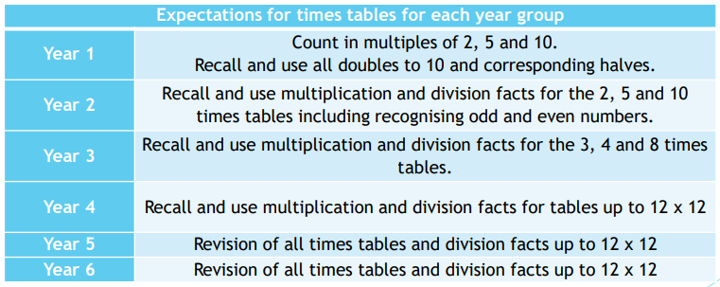

Curriculum Expectations
Primary-school children are expected to know all their times tables up to 12x12 by the end of Year 4.

Slide 4
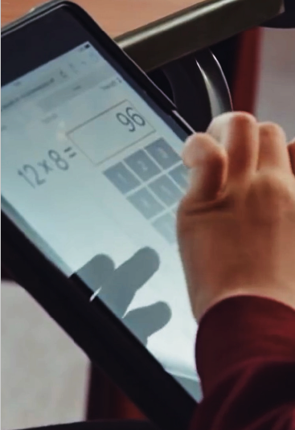
What is the purpose of
the multiplication tables check?
The purpose of the MTC is to determine whether pupils can recall their times tables fluently, which is essential for future success in mathematics. It will help schools to identify pupils who have not yet mastered their times tables, so that additional support can be provided.

Slide 5
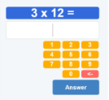
How will children be assessed?
The MTC is an on-screen check consisting of 25 times tables questions. Your child will answer 3 practice questions before moving on to the official check, and will then have 6 seconds to answer each question. On average, the check should take no longer than 5 minutes to complete.
For a similar format of the check, please refer to:
https://www.timestables.co.uk/multiplication-tables-check/

Slide 6
When will children be assessed?
Schools have a 3-week check window from the 6th – 24th of June to administer the MTC.

Slide 7
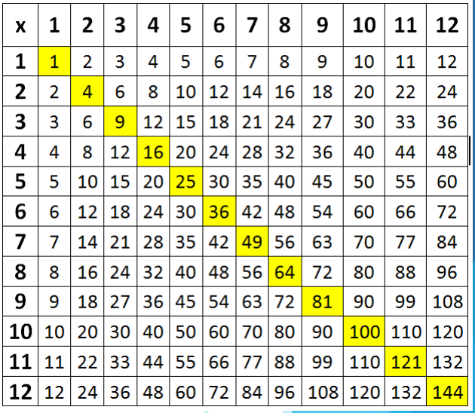
Learning Times Tables
This diagram shows the 144 times tables multiplication facts that every child needs to commit to memory.
Children need to be able to recall any times tables answer within two or three seconds. This leaves no time for counting the way up to the answer from 2x, 3x, 4x etc. – the answer has to ‘pop’ out of memory pretty much instantly.

Slide 8
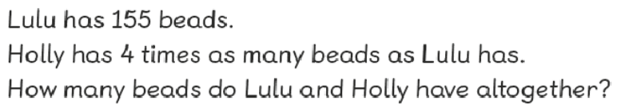
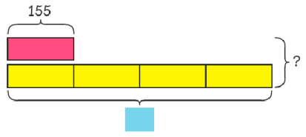
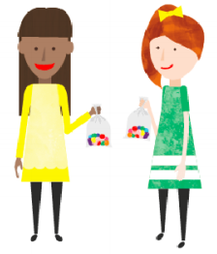
Why do we learn times tables?
In primary school, times-tables knowledge is vital for quick mental maths calculations and problem solving, as well as for many of the topics children learn in KS2 (division, fractions, percentages).
Being fluent in your times tables is essential for success in Mathematics.
Children who can’t recall their times tables may find other areas of mathematics harder, due to cognitive overload.
In secondary school, good multiplication skills are a great help when starting to learn algebra, as well as chemistry, physics, biology and computing, all of which depend heavily on maths knowledge.

Slide 9
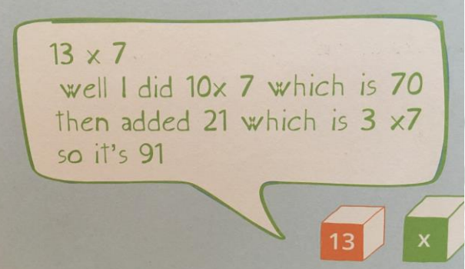
Why do we learn times tables?
Automaticity with facts is essential so the mind is free to think about concepts.
Children need to move away from inefficient counting strategies as quickly as possible.
BUT knowing your times tables is so much more than just memorisation.
Children aren’t just thinking “I know this fact” but “I know this fact therefore I can work out this…”

Slide 10

What language do we use?
There are many different ways to say the tables and they’re all correct. For example we have;
Three times eight is…  Three multiplied by eight…  Three eights are…  Three lots of eight… 
Three groups of eight..

Slide 11

Useful Tips
Stick to one table at a time to minimise confusion.
Start with chanting and writing them out slowly in order.
Then move on to completing the answers quickly in order – on paper or verbally with your child.
Finally, move on to completing the answers in any order.
Keep reminding your child that 3 x 4 is the same as 4 x 3 – this effectively halves the number of tables facts children have to learn.
Each table has a square number 3 x 3, 7 x 7 etc. These are special numbers that can act as a memory hook – emphasise them!
Talk about the numbers as you are encountering them “ 5 x 7 = 35 that’s our house number” – this makes more memory hooks.

Slide 12
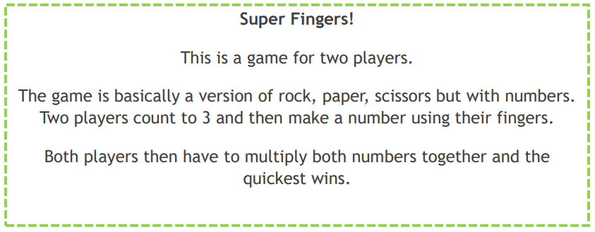
Games to try at home…

Slide 13
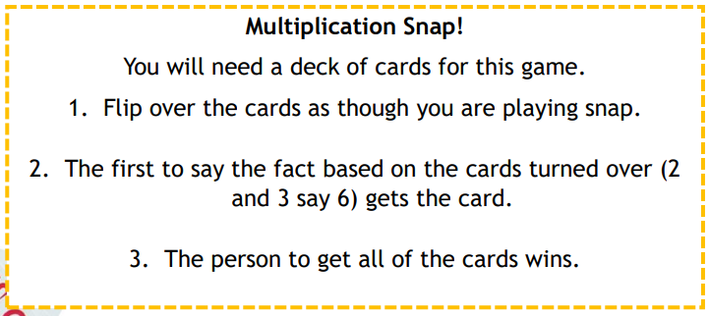
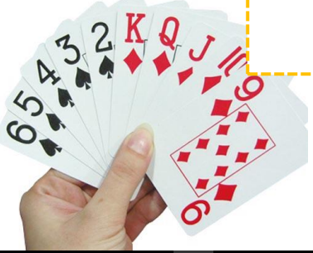
Games to try at home…

Slide 14

Useful Websites
https://www.topmarks.co.uk/maths-games/hit-the-button
https://play.ttrockstars.com/auth/school/student/30021/password
https://www.timestables.co.uk/times-tables-memory.html
https://mathsframe.co.uk/en/resources/resource/477/Multiplication-Tables-Check
Times tables collection - BBC Teach
Percy Parker times table songs

Slide 15
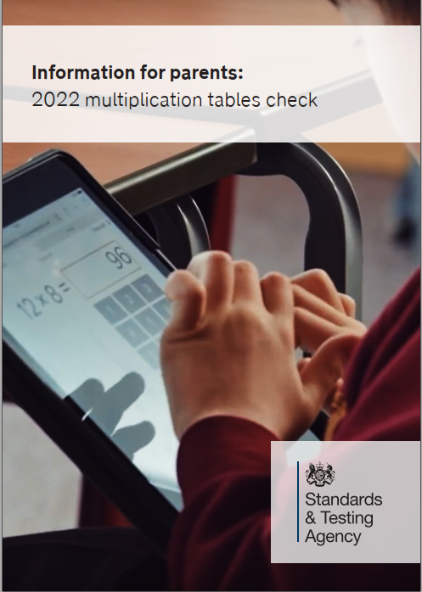
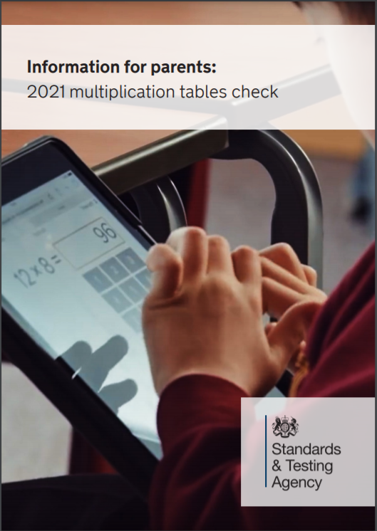
Information for parents:
2022 multiplication tables check
For further information, please visit the government website
Multiplication tables check: information for parents - GOV.UK (www.gov.uk)

Slide 16

Questions?
If you have any questions, please ask.

