Slide 1
Welcome to Class 4
Mrs Hunt, Miss Callcut and Miss Bebbington
Notes:
Roles within the class

Slide 2
What does Year 4 look like?
On a Monday Miss Callcut will be the class teacher and Tuesday-Friday Mrs Hunt will be the class teacher.
Everyday we do Spelling, Guided Reading, English and Maths.
In the afternoon, Miss Callcut teaches Art, Spanish and SMSC. Mrs Hunt teaches P.E, R.E, Computing and Theme which includes: Science, History, Geography and D.T.
Music and Wild Tribe will also be taught by specialist teachers.

Slide 3
Expectations
Correct school uniform (named)
Correct PE kit ( named)
Water bottle (water and not juice, named)
Coat
Hat/Suncream in warm weather
Attendance
Children need to be in school by 8:45am each day.
It is paramount that children are in school as much as possible. As a school, our attendance target is 95%.
Notes:
Aim for all to achieve to the best of their ability

Slide 4
Expectations
Learning Behaviours
Independence: - being prepared for lessons
( resources / PE kit, correct school uniform /attendance etc)
Using resources/displays to support independent learning.
Responsibility – for learning and behaviour.
Notes:
Aim for all to achieve to the best of their ability

Slide 5
Year 4 – Expectations : see parent information sheet
Reading: Accelerated Reader
Spelling : Year 3 / 4 common exception words
Writing: including cross –curricular
Maths: main focus will be multiplication please encourage regular practice over the holidays
Notes:
Expectations of presentation- completion of tasks

Slide 6
Homework
Maths, English and Topic Homework will be sent out every four weeks. Children will choose either an English or Maths to do each week and one Topic for the four weeks.
Reading (Accelerated Reader books) every night please.
Any work which is not completed in class/school.

Slide 7
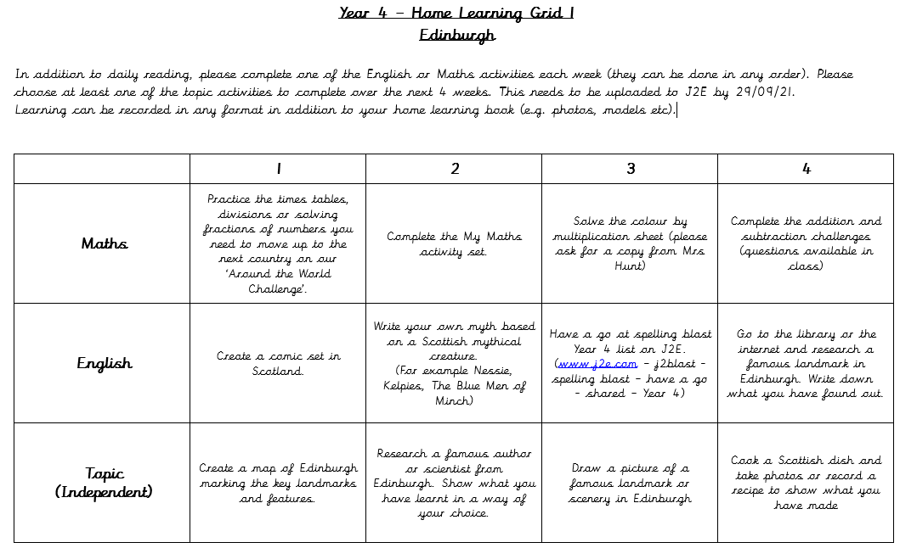
Home Learning Grid – Example Edinburgh

Slide 8
Home Reading
Accelerated Reader: A Guide for Parents
From Year 2 -6, children take part in the Accelerated Reader programme, which is designed to do the following things:
Find books that are the right level for your child
Encourage your child to read more
Improve your child’s reading ability.
The children quiz when they have finished reading their book and earn a raffle ticket if they achieve 100%

Slide 9
Home Reading
“How much should my child read each day?”
According to Renaissance Learning’s research, children who read at least 20 minutes a day with a 90% comprehension rate on AR quizzes see the greatest gains.
Therefore, your child should have at least 20 minutes set aside for reading during day.

Slide 10
Communication
Letters home- spares can be collected from
the office.
Texts
Website: check for key dates and upcoming events
Twitter Feed
Newsletter emailed out- this also contains key information.
Please make appointments at reception if you would like to see your child’s teacher.
Please ensure that contact details and medical details are up to date.

Slide 11
Any Questions?
I am really sorry that we can not do this in person this year. If you have any questions please feel free to ask in the morning as you drop your child off or leave a message with the office and I will get back to you as soon as I can.
I look forward to meeting you all in September.

