Slide 1
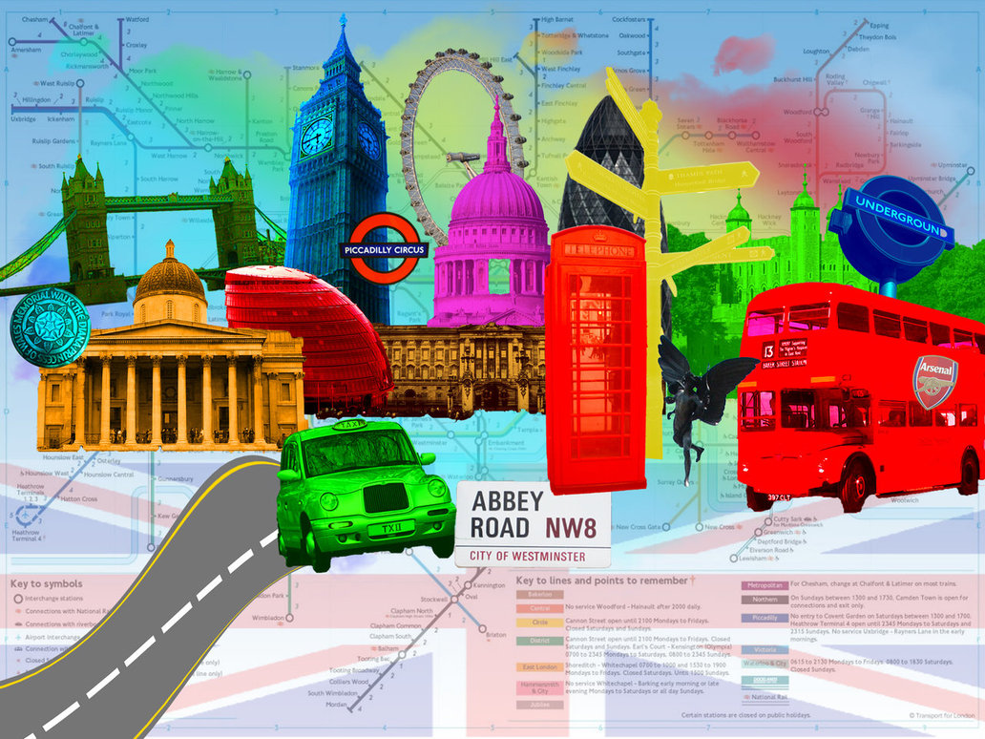
London Visit
23rd and 24th January 2013
Class 5’s London Trip
29-30th April 2024

Slide 2
London visit itinerary.
Monday 29th April
Leave school at 6am. Children to arrive at school at 5.30am.
Lunch in central London and scenic walk to London Eye (depending on travel time)
London Eye flight at 1.00pm (arrive at1.30pm).
After London Eye walk along South Bank to HMS Belfast to settle in, look around ship and an activity.
Walk over Tower bridge, around the Tower of London to dinner.
Dinner at approx. 7.00pm then return to ship.

Slide 3
Tuesday 30th April
Breakfast at 7.00am.
Coach to Hyde Park, then scenic walk to Science Museum.
10.00am Science Museum. We have open entry to the museum, a Science Show and entry into the Wonderlab.
Travel by coach to Houses of Parliament.
Visit the Houses of Parliament for workshop and tour at 2.20pm (finish 4.30pm).
Board coach outside Houses of Parliament.
Latest estimated arrival back at school: 10pm (stop at a service station for tea).

Slide 4
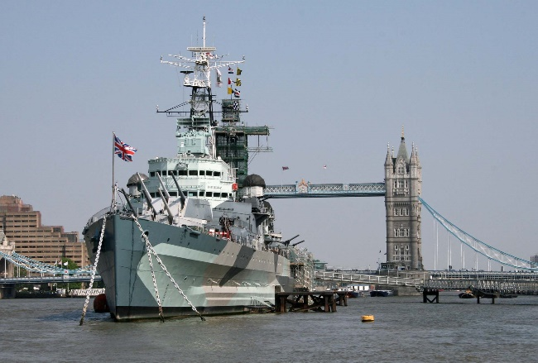
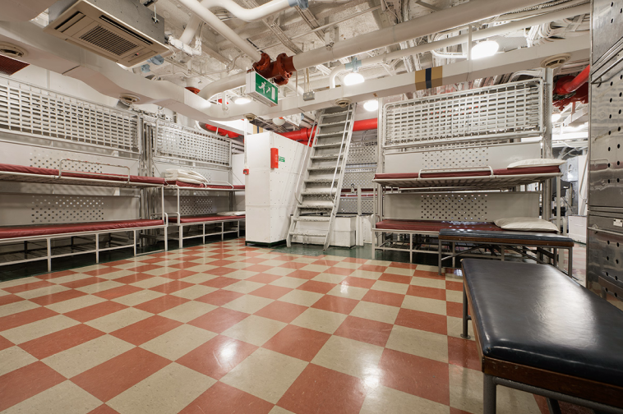
Accommodation
HMS Belfast
(Moored near Tower Bridge).
All rooms are on the same deck (including staff).
Rooms are dormitory style with bunk beds. Separate rooms for boys and girls.
Secure accommodation. No other schools staying at same time. Escort on and off ship by concierge.

Slide 5
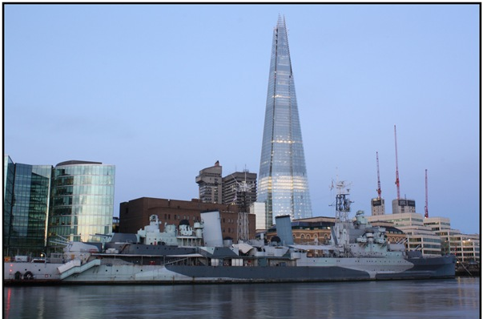
Packed Lunch
Packed lunch provided by HMS Belfast. Made fresh on the Tuesday morning.
They Include:
A sandwich
A piece of fruit
A packet of crisps
A carton of juice
A mini muffin
A chocolate bar

Slide 6
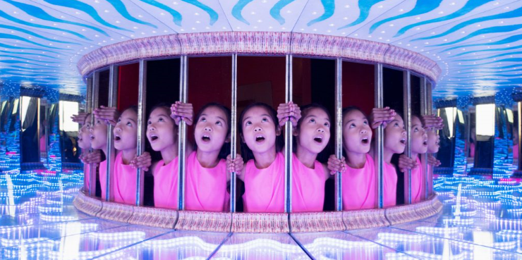
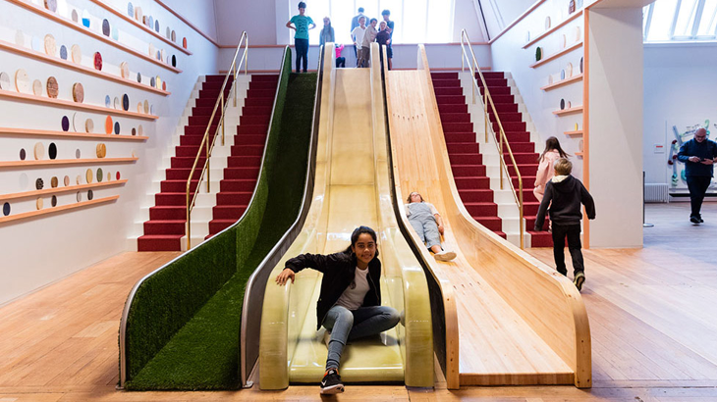
More about … Science Museum
Wonderlab: The Equinor Gallery
The gallery is packed with over 50 hands-on experiments and experiences. To discover what they’re all about, you need to look closer, ask questions and get creative…
We’ll join one of the team of Explainers to discover the power of electricity, sending lightning bolts live across the gallery.
See a liquid that flows weirdly when you move magnets near it.
Use thermal imaging camera to find out how hot and cold things are.
https://www.youtube.com/watch?time_continue=20&v=NWeoBAzBJJ4

Slide 7
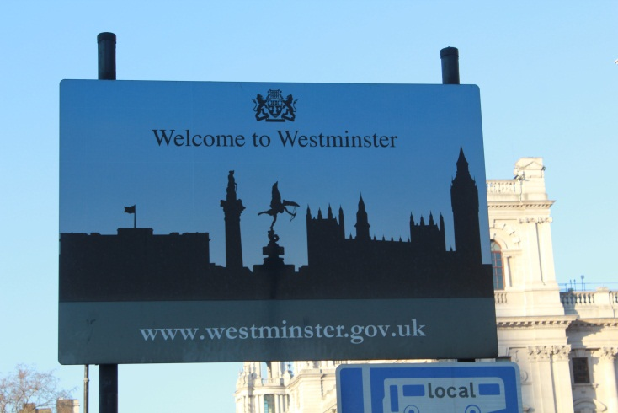
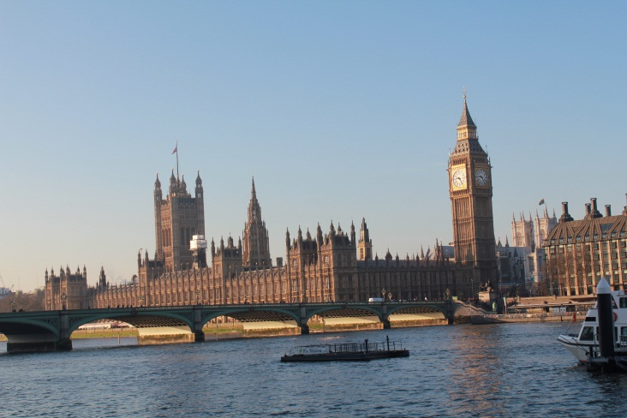
More about … The Houses of Parliament
Tour of the Houses of Parliament.
Workshop on elections and voting.
A possible question and answer session with Scott Mann (our local MP).

Slide 8
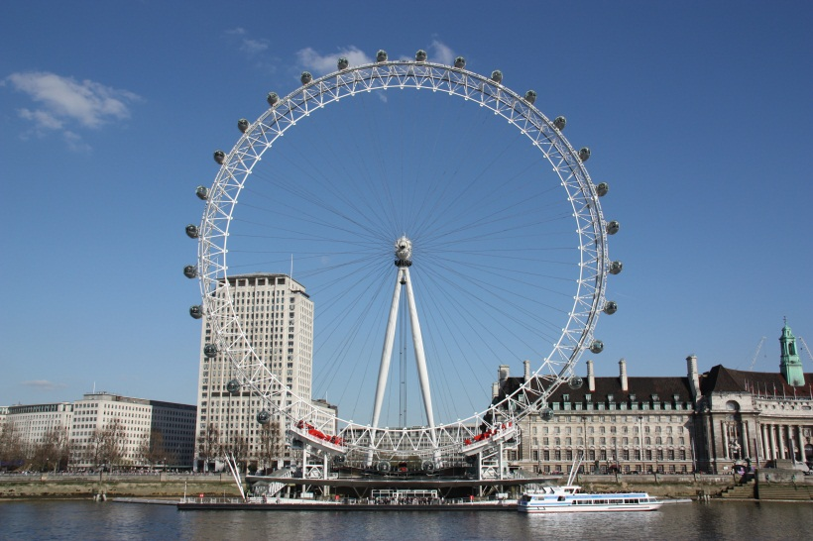
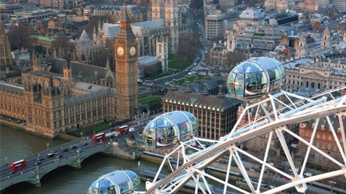
More about … The London Eye
There are 32 sealed and air-conditioned ovoid passenger capsules, attached to the external circumference of the wheel and rotated by electric motors. Each of the 10-tonne capsules represents one of the London Boroughs. Passengers are free to walk around or sit and we have chosen the guided flight, with a tour guide pointing out sights and answering questions. The wheel rotates at 26 cm per second, so that one revolution takes about 30 minutes. This rotation rate is slow enough to allow passengers to walk on and off the moving capsules at ground level.

Slide 9
Members of staff attending
Mrs Furber- Headteacher
Mrs Baxter – HLTA, First Aid.
Mrs Paul – Child Protection, Pastoral Team, First Aid.
Mr Gilbert –TA.
Staff members have attended this trip many times and also have an excellent knowledge of the area.

Slide 10
Children’s health and safety
During activities, the children will be organised into groups led by a member of staff (no more than 8 in each group).
Limited walking through London.: coach picks up and drops off at most locations.
Adults will wear fluorescent jackets.
All children will wear an ID lanyard with relevant emergency information.
Belfast has a locked gate, CCTV and security.
Mrs Baxter (First aid trained) will administer any medication.
Mrs Paul will carry all emergency contact information for each child.
We will contact school as soon as we … have arrived in London, leave London and we are within half an hour of school. Parents will receive a text each time. We will keep school updated with how each activity has been.

Slide 11
General reminders
The children are allowed to wear non-school uniform for the duration of the trip but need to be prepared for wet weather. We recommend that they wear trousers, t-shirt, jumper/fleece and shoes or trainers (waterproof).
Pack bags with your child so that they know what items they are responsible for. (See kit list.)
Overnight bag (Large rucksack/sports bag/small suitcase).
Day bag (Small backpack).
Packed lunch in a plastic bag not a lunch box. If your child normally has a free school meal, a packed lunch will be provided for them if requested.
Sleeping bag, pillowcase and a towel are needed.
Optional: Camera (preferably disposable or a low value digital camera).
Optional: Items to entertain themselves on the coach. This may include an MP3 player or a handheld games console.

Slide 12
Kit list
Overnight bag (large rucksack/sports bag/small suitcase)
One change of clothes – trousers, t-shirt, jumper/fleece.
Socks x2
Underwear x2
Sleeping bag and pillowcase
Nightwear
1 spare pair of shoes or trainers (waterproof)
Wash bag
soap
toothbrush
toothpaste
roll on deodorant (strictly no aerosols)
hairbrush/comb
1 large towel
Small torch
Optional: reading book
Optional: teddy

Slide 13
Kit list contd
Day bag (small backpack)
Waterproof coat
Packed lunch in a plastic bag not a lunch box (if your child normally has a free school meal please notify us on the appropriate form and a packed lunch will be provided for them).
Filled water bottle
Suncream
Optional: Camera (preferably disposable or a low value digital camera)
Optional: Items to entertain themselves on the coach. This may include an MP3 player, a handheld games console or small tablet.
Snack or treat to share.

Slide 14
General reminders contd.
Other items (to be handed to an accompanying member of staff prior to departure).
Essential: £10 for tea at a service station on the way home. This must be in a named envelope.
Medication: labelled with name and dosage.
Optional: pocket money. This must be no more than £10. To be in a named wallet/purse.
Items Prohibited
Mobile phones, iPads, Laptops, tablets, kindles (anything that connects to internet), expensive cameras and aerosols.
Please clearly label all of your child’s belongings. The school accepts no responsibility for lost or damaged items. We will collect and store all electronic items before bed to prevent loss of sleep!

Slide 15
General reminders contd.
Ensure you have completed and returned medical forms.
Send in any outstanding payments.
Don’t hesitate to speak to any of the school staff team if you have any worries or questions.

Slide 16
London Visit
23rd and 24th January 2013
Class 5’s London Trip
29th – 30th April

